Slide 1
Reflections On Grading & Markscheme-Based Assessments In Vocational Qualifications Gavin Busuttil-Reynaud, Director, AlphaPlus
May 2019

Slide 2
Presentation Covers
Why Grade
Grading Approaches
Selecting the Right Grading Approach
Grading Model
Examples
Advantages and Disadvantages
Advantages and Disadvantages
Notes:
Why do we grade (at all)?
Specifically what does grading mean in a vocational context?
Why do assessment methods look like they do? – Validity / purpose considerations
How do these interact with the requirement for grading?
Specific examples of approaches applicable to VQ AOs

Slide 3
It’s up to you now

Slide 4
Overview of vocational qualification policy changes
Over the past decade, we've seen several major reviews and inquiries.
A key theme across all reviews was about increasing the currency of vocational and technical qualifications.
Government policy responses have included:
requiring grading structures within performance table qualifications; □ review of funding formulas;
introduction of graded end-point assessment;;
increasing focus on ‘parity’ between general and vocational qualifications.

Slide 5
Original DfE Benchmark Principles
GRADING
SYNOPTIC ASSESSMENT,.
1
with a minimum of 3 passing grades
3
not necessarily external
EXTERNAL ASSESSMENT
INTERNAL ASSESSMENT
2
30% - 40% minimal external assessment (dependent upon whether the qualification is a Technical Certificate, Technical Level or Advanced General Qualification
4
subject to appropriate controls

Slide 6
DfE Guidance on Grading
By providing access to subject areas and skills that the students find engaging whilst also ensuring that extra work and ability can be reflected in differentiated outcomes.
Increases student motivation
Challenge should be provided such that a combination of hard work and ability are recognised through differentiated outcomes;
Provides challenge
Ensures rigour
Provide differentiation between students on a scale which will be useful for the gatekeepers responsible for the students’ progression, for example Higher Education and employers
Distinguishes between students by level of achievement

Slide 7
Do these principles always hold?

Slide 8
In support of the DfE Grading requirement, awarding organisations should:
Adopt
Avoid
explain how the overall grade will be calculated, clarifying the contribution of individual assessments (including those that do not contribute to the grade). Where units and/or assessments are weighted, explain how the weighting has been worked out, and show how each unit and/or assessment is reflected in the overall grade;
explain the signal that is provided of a student’s attainment if it is possible to achieve the qualification having failed key components such as any mandatory content, the external assessment and synoptic assessment;
explain how the attainment of individual students will be identified in a group task;
provide marking and grading criteria that are clearly show how a student would demonstrate achievement across the grading scale.
basing grades solely on the percentage of questions that a student gets right in a test. A more qualitative approach, which recognises the relative size and importance of some questions, provides a better option;
using a pass/fail, binary or ‘tick box’ approach which does not allow students to demonstrate higher levels of attainment.

Slide 9
Ofqual’s approach
■ We’ve increased our commitment to researching vocational and technical qualifications
■ We want to improve understanding of best practice in assessment and grading within the sector
■ There will be choices to be made on assessment and grading across vocational qualification

Slide 10
Implications of Grading for Design of Assessment
General Qualification Assessment
It is considered to be good practice to design assessments that use the full mark range as this allows for better differentiation between students. This assumes that differentiation is a key purpose of the assessment, and leads to the most reliable allocation of students into categories or grades. An implication of this is that it is possible for a student to pass a module by only getting say 50% of the items right, maybe even less. This is a very different approach to assessments which are criterion referenced and mastery-based, with an expectation that students will demonstrate competency in the majority of the criteria.
Overall Grade
The implications of producing an overall grade for an assessment, rather than component level results. This approach to assessment implies that at some level the content of the components is comparable in some way such that is can be added up on a like for like basis to give a final measure of ability in, as for ABMA, Business Management. This may not always be the case.
Grading
Where grading approaches are used, this frequently goes hand in hand with compensatory models of assessment. By its nature, to be awarded grades some students have to get a proportion of the items wrong; however, it is usually impossible to know from the grade what they can and what they can’t do.
Synoptic Assessment
If adopting synoptic assessment, while not specifically being a grading issue, this does add extra complexity. The weight given to this element and how it is combined with the results from the other components become important. Is it acceptable to know all the elements of a ‘subject’ but not how it works as a whole? Should the synoptic element become a hurdle? If not, what is the point of mandating its inclusion?
A Compensatory Model of Assessment
Is further affected when a number of assessment components are combined to come up with an overall grade. It may be possible to perform poorly in certain components, suggesting a weakness in a whole area of a subject or a whole skill, but this is masked, or compensated for, by strengths in other areas.

Slide 11
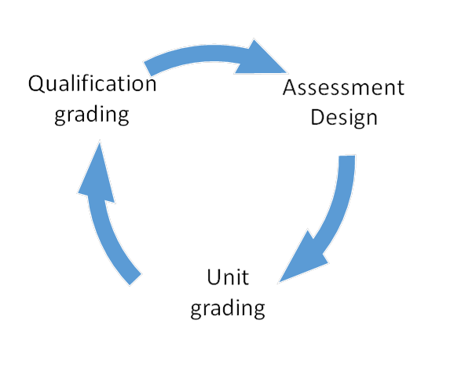
Selecting the Right Grading Approach
Decisions need to be made in each of these areas, generally in the order presented, but the decisions interact so an iterative approach is required.
Qualification Grading
Assessment Design
Grading at the qualification level.
The design of the assessment, including grading by scoring and using standardised scores
Unit Grading
Grading at the unit level
Notes:
CHANGE THE COLOUR OF THE ARROWS IN THE DIAGRAM ABOVE SO THAT THEY MATCH THE NEW FORMAT
THIS IS THE TEXT IN THE SMALLER BOXES
The design of the assessment, including grading by scoring and grading on the curve
Grading at the unit level
Grading at the qualification level.
ADD THIS IN A TEXT BOX AT THE BOTTOM
Decisions need to be made in each of these areas, generally in the order presented, but the decisions interact so an iterative approach is required.

Slide 12
Synoptic Element
Holistic or atomistic marking and grading of synoptic task (or a hybrid?
What are the main elements of the subject that need to be assessed in terms of knowledge, skills and understanding?
MAIN ELEMENTS
EXTERNAL ASSESSMENT
Are there particular elements that lend themselves to external assessment?
UNITS WEIGHTING
Is it possible to break the subject down into a small number of meaningful units? Approximately, what proportion of the grade should each of these units make up?
EVIDENCE OF ACHIEVEMENT
Are there elements where it is easy (-ier) to collect evidence of achievement at different levels?
ADD MOST VALUE
What type of assessment would add most value as a synoptic element?
Notes:
PASTE EACH ONE OF THESE INTO TEMPLATE – CHANGE OR DELETE THE SYMBOLS
MAIN ELEMENTS
What are the main elements of the subject that need to be assessed in terms of knowledge, skills and understanding?
UNITS WEIGHTING
Is it possible to break the subject down into a small number of meaningful units? Each of the proposed new ABMA Regulated Diplomas requires study of five separate units at each level. Approximately, what proportion of the grade should each of these units make up?
ADD MOST VALUE
What type of assessment would add most value as a synoptic element?
EXTERNAL ASSESSMENT
Are there particular elements that lend themselves to external assessment?
EVIDENCE OF ACHIEVEMENT
Are there elements where it is easy (-ier) to collect evidence of achievement at different levels?

Slide 13
Grading by Scoring
Scoring or marking can be used to both achieve fairness and then spread the burden of judgement amongst more markers. Scoring can be, and is, used in vocational qualifications as a means of allocating grades and a straightforward way to do this is by using the sum of all the partial scores and then define cut scores or cut off points, to determine the grade. Issues associated with using scoring to determine grades include all of the above features.
Selecting a cut score
Compensation
Weighting
Is there a clear link from the cut score to the performance at the grade boundary?
Is it acceptable that strong performance in one area off sets weak performance in another area?
Are all learning outcomes in a unit of equal value?
How do you score performance against a particular assessment criteria?
Are all the units of equal importance?

Slide 14
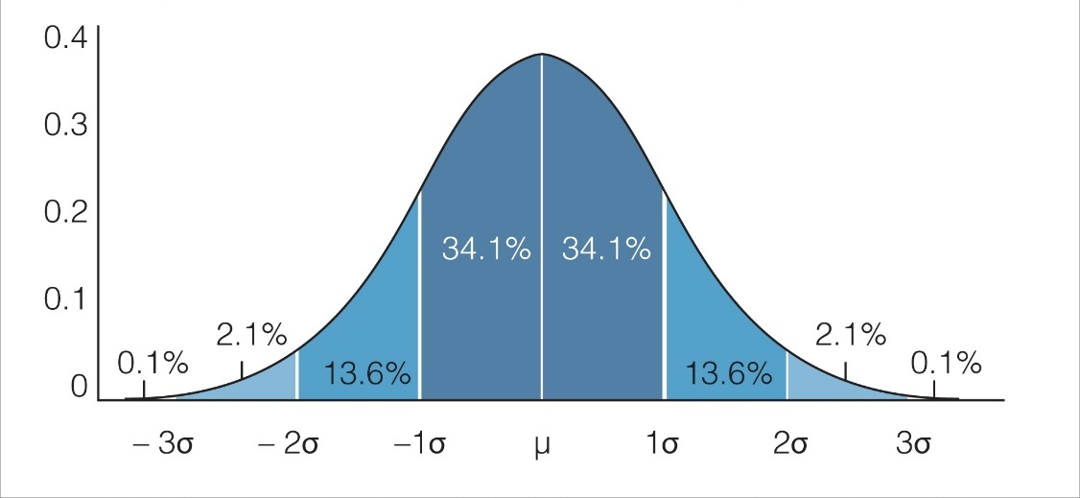
Grading on standardised scores – Norm refencing

Slide 15
Grading at the unit level
 | Pass/ fail | Graded results
Individual items which are ‘marked’ to achieve a total score, which is then converted to grades | Useful for topics that have lots of separate Assessment Objectives to be assessed, where objective or short answer items are an option, and for which there is a requirement for competence to be shown in all areas. | Useful for topics that have lots of separate Assessment Objectives to be assessed, where objective or short answer items are an option, and for which compensation between elements is an option.
Performance or open ended tasks which are assessed holistically against descriptors to achieve a grade | Useful for topics in which an open-ended task is the most appropriate form of assessment, which is either achieved or not achieved. | Useful for topics in which an open-ended task is the most appropriate form of assessment, and for which different levels of achievement are possible.
Unit v Holistic Grading
.

Slide 16
Grading at the qualification level
This stage links closely back to decisions made at the assessment design stage about the different units and their relative importance. The decisions about how the different units will be assessed also has an impact at this stage. Based on earlier decisions, consideration is now needed about all of the above features.
Hurdles
Comparable
Whether the outputs from the different units are ‘comparable’ and if not, whether some kind of translation is required to put them all onto the same scale. For example how will you combine a pass/fail result with a unit graded pass, merit, distinction?
Whether certain units must be passed for an overall pass to be achieved (whether some units become a hurdle) or whether compensation between units is allowed.
Unit Weightings
Grade thresholds
Weightings of the different units only make sense if the scale between units is comparable
For mark-based combinations, what the grade thresholds will be for the final grades, or for cases where grades are already allocated at the unit level, what combinations of grades are required to achieve each final grade.

Slide 17
Examples -Pearson BTEC Level 3 National Diploma in Business
The design of the assessment
Calculating grades at unit level
Calculating a grade at
qualification level
There are 6 mandatory units. Students must complete and achieve all 3 of the mandatory external units - one is synoptic. Students must complete all 3 mandatory internal units also - two are synoptic. Students must achieve a pass or above in at least 2 internal units and 2 external units.
The qualification is graded by unit using grade descriptors for internally assessed units and raw marks for externally assessed units. Grading at unit level can allow for compensation within the unit where, for example certain learning aims or outcomes are achieved more securely than others yet overall grade descriptors are met.
Students are awarded a qualification grade for achieving a sufficient number of points within the ranges shown IN TABLE 1 AND TABLE 2.
Note that the student in this example has achieved a Pass or above in Units 2, 3 and 6 and a Pass or above in at least two Units 1, 4, and 5. With 78 points, the student has sufficient points for a PP grade.
This qualification satisfies DfE performance table requirements in terms of appropriate assessment and grading as it is 720 GLH in size, consists of 8 units of which 6 are mandatory and 3 are external. The mandatory content at 83% and external assessment (45%) are above the minimum requirements. There is a distinction, pass, merit, fail structure and the grading applies to the overall qualification.
The FIRST table below shows the number of points available for internal units.
Raw marks from the external units will be awarded points based on performance in the assessment. The point scores available for each external unit at grade boundaries are as IN TABLE 2
Advantage - students can show strengths at unit grade which don’t affect overall qualification attainment.
Disadvantage - at qualification level it is not possible to obviously see which content a student has passed; this might be important for specific sectors.
Points for each external unit are automatically calculated once the external assessment has been marked and grade boundaries have been set.
Example: Achievement of a Diploma at a PP (the equivalent of 2 A levels) grade
 | GLH | Type (Int/Ext) | Grade | Unit points
Unit 1 | 90 | Int | Pass | 9
Unit 2 | 90 | Ext | Pass | 9
Unit 3 | 120 | Ext | Pass | 12
Unit 4 | 90 | Int | Pass | 9
Unit 5 | 90 | Int | Pass | 9
Unit 6 | 120 | Ext | Merit | 20
Unit 8 | 60 | Int | U | 0
Unit 10 | 60 | Int | Merit | 10
Totals | 720 |  | PP | 78
Diploma
720 GLH
Grade | Points threshold
U | 0
PP | 72
MP | 78
MM | 104
DM | 124
DD | 144
D*D | 162
D*D* | 180
The qualification is structured in units of different GLH size. Units are assessed using a grading scale of Distinction, Merit, Pass and Unclassified. All mandatory and optional units contribute proportionately to the overall qualification grade.
 | Unit size
 | 60 GLH | 90 GLH
U | 0 | 0
Pass | 6 | 9
Merit | 10 | 15
Distinction | 16 | 24
 | Unit size
 | 90 GLH | 120 GLH
U | 0 | 0
Pass | 9 | 12
Merit | 15 | 20
Distinction | 24 | 32

Slide 18
Digital Industries Trailblazer Apprenticeship (e-skills UK) – Software Developer
Assessment Units | Graded units | Weighting and combination | Rationale
Formative portfolio Knowledge tests summative portfolio synoptic project structured interview | summative portfolio synoptic project structured interview | Holistic judgement by assessor against standards and grading criteria – extremely loose description of interpretation of pass, merit and distinction to be exemplified and enforced using moderation by a single external agency. | Three forms of assessment are to ensure an accurate, holistic view of capability is taken and that skills, knowledge and behaviour can be integrated in practice. Internal assessments and knowledge tests are not graded so that they can vary according to employers’ needs. Summative portfolio ensures coverage of the standard. Synoptic project is under controlled conditions to ensure comparability of assessment demand and freedom from complicating factors (work interruptions etc). Interview is to probe breadth and depth of understanding and capability.

Slide 19
Automotive Trailblazer – Product Design & Development Engineer
Assessment Units | Graded units | Weighting and combination | Rationale
NVQ based skills assessment (internal and external) Knowledge tests (external – degree level) Behavioural assessments Employer professional interview (Internal) | Knowledge tests Behavioural assessments | Certificate is pass/fail with a performance transcript – no combination of grades and hence no compensation. | Skills assessment is competency based and therefore pass/fail and ensures the breadth of the qualification Knowledge tests differentiate based on score to give pass, merit and distinction grades Behaviour is rated on the Behaviourally Anchored Rating Scales (BARS). This system uses a five-point grading scale (5 Outstanding; 4 Very Good; 3 Acceptable; 2 Improvement required; and 1 Unacceptable) in relation to five broad performance areas (Working effectively in teams; Focus on quality and problem-solving; Personal responsibility and resilience; Effective communication and interpersonal skills; and Continuous development). Assessment model has been developed in conjunction with C&G, EAL and Pearson

Slide 20
Food and Drink – Maintenance Engineer
Assessment Units | Graded units | Weighting and combination | Rationale
Skills assessment based on observation and artefacts Written and oral knowledge tests Portfolio based behaviour assessment Synoptic practical and knowledge test centre day Employer verification | All components graded pass/ merit/ distinction | Unclear how (if) elements are combined | Existing or new external qualifications can be incorporated to achieve the skills and knowledge assessment to achieve cost-effective and reliable external assessment. Use of portfolio evidence ensures that skills and knowledge can be applied in a real work context. External assessment centre for synoptic test provides independent judgement and comparability of assessment. Note approx. 150 people per year are expected to undertake this standard, hence the practicality of this approach.

Slide 21
Thank you.
AlphaPlus Consultancy Ltd

