Slide 1
Ofqual update
Lucy Sydney
AO Forum, London, 14 May 2019

Slide 2
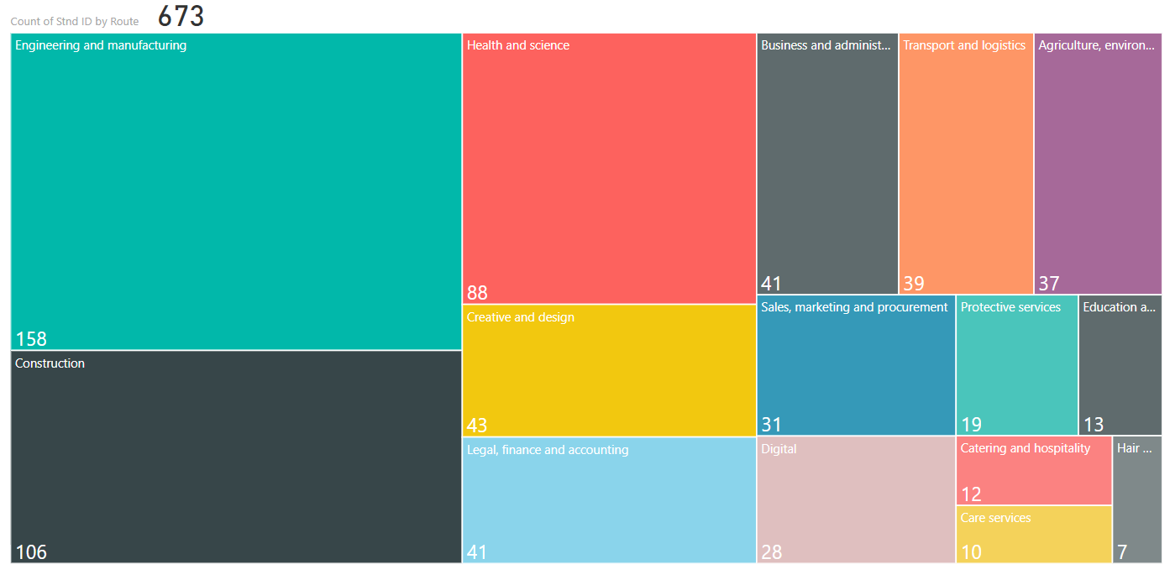
Apprenticeship landscape

Slide 3
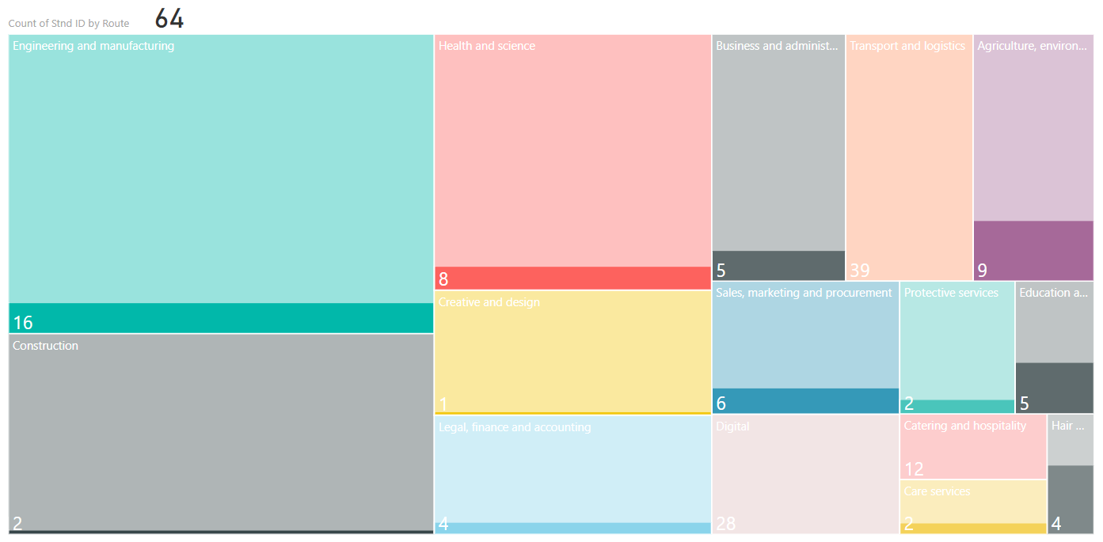
Apprenticeship landscape

Slide 4
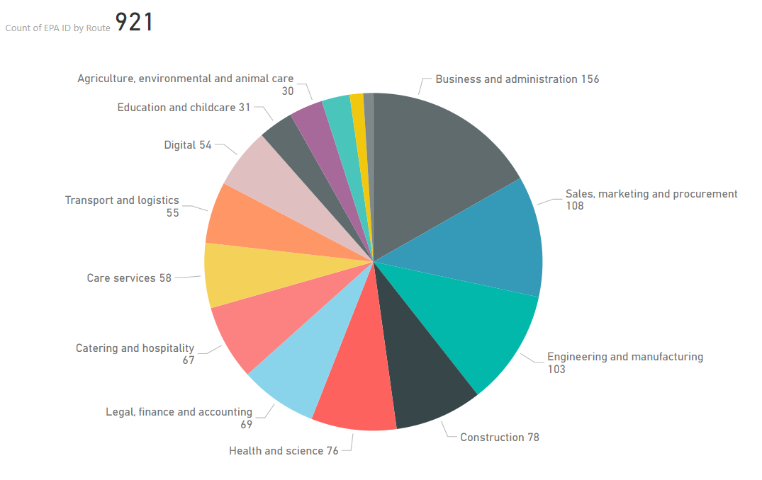
EPAs from approved standards
Currently a potential 921 EPAs from 435 approved Standards
Notes:
Based on February figures
There are c670 standards on the IfA website (changes frequently) – 400 of which are ‘approved for delivery‘

Slide 5
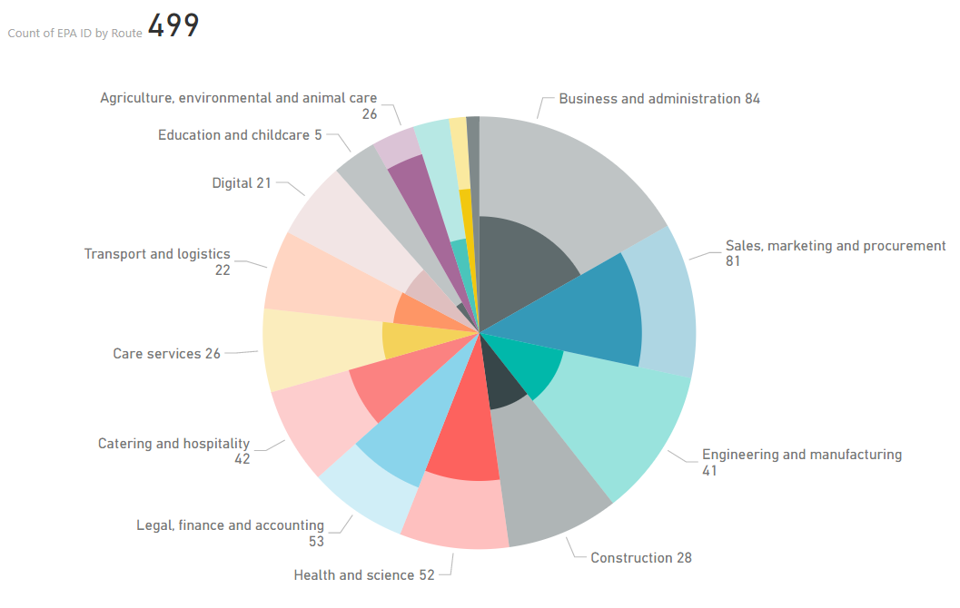
EPAs from approved standards
Currently a potential 921 EPAs from 435 approved Standards
Regulated community accounts for 499 (54%) of potential EPAs

Slide 6
Apprenticeships
EQA provider landscape
Reviewing Assessment Plans
Recognition
Technical evaluation
Audit
Enforcement

Slide 7
T Level responsibilities: the Institute & Ofqual
The Institute has overall responsibility for the Technical Qualification
Ofqual will regulate the Technical Qualification (and any other qualifications as required) within the T Level programme

Slide 8
T Levels: Approval of the Technical Qualification (TQ)
Awarding Organisations will be asked to submit materials (e.g. assessment strategy, sample assessment materials) at specific contract milestones. These will be shared simultaneously with Ofqual
The Institute will evaluate the materials according to the Service Requirements specified in the contract
Ofqual will accredit TQs against the following Accreditation Criterion:
    “An awarding organisation must demonstrate to Ofqual’s satisfaction that it is capable of complying, on an on-going basis, with all of the General Conditions of Recognition that apply in respect of the qualification for which it is seeking accreditation, including all relevant Qualification Level Conditions and Subject Level Conditions.”
The Institute makes the final approval decision, taking in to account Ofqual’s accreditation decision.

Slide 9
TQs: Ongoing Monitoring and Supervision
The Institute will require regular meetings and written updates from AOs to monitor progress against the contract
Awarding Organisations must continue to comply with Ofqual’s monitoring requirements as part of the General Conditions of Recognition
Notification of adverse effects (event notifications)
Annual statement of compliance
The Institute and Ofqual will be working collaboratively throughout the duration of the contract. Any information submitted to Ofqual on TQs will be shared with the Institute and vice versa
Ofqual and the Institute will utilise contract management or regulatory levers as appropriate if AOs are found to be non-compliant.

Slide 10
Functional Skills Qualifications – English and Maths
Subject content published February 2018
Our rules published July 2018
AOs are developing assessment materials for reformed FSQs and we are reviewing them through our technical evaluation process.
Information on our website: https://www.gov.uk/government/collections/functional-skills-qualifications

Slide 11
New national standards for essential digital skills
Using devices and handling information
Creating and editing
Communicating
Transactions
Being safe and responsible online
Beginner
covering Entry levels 1-3
Essential
covering Level 1

Slide 12
Digital qualifications funded through the adult digital entitlement
Essential Digital Skills qualifications | Digital Functional Skills qualifications
First teaching from September 2020 | First teaching from September 2021
New qualifications available at Entry level 3 and Level 1 | Replacing Functional Skills in ICT
Likely to be the most appropriate qualification for adults with no or low digital skills wishing to gain digital skills for a specific life, work or study purpose e.g. to apply for jobs online, to manage finances online, to access government services on-line | Likely to be the most appropriate qualification for adults with no or low digital skills wishing to confirm they have the full range of digital skills needed for employment or further study
Qualifications based on new national standards for essential digital skills | Qualifications based on DfE subject content derived from the national standards for essential digital skills
30-50 guided hours of learning | Likely to be 55 guided hours of learning

Slide 13
Digital FSQs reform timescale
Autumn
2018
Subject content commissioned by DfE​
May
2019
DfE consultation on draft subject content
Ofqual consultation on assessment policy
Autumn
2019
DfE publishes final subject content
Winter 2019/20
Ofqual technical consultation on draft Conditions and Guidance
Summer
2020
Ofqual publishes final version of Conditions and Guidance
September
2021
First teaching of new Digital FSQs

Slide 14
Moderation and verification of centre assessment judgements
Proposed changes to awarding organisation controls with centres where centres make assessment judgements on their behalf
Consultation on our proposed approach between 25 February and 20 May. Stakeholder events run during April and May.
Proposals intended to ensure that:
  awarding organisations have the right controls in place with centres to ensure the standards of qualifications
  assessments remain manageable and deliverable for those that use them
  our rules allow them to do this

Slide 15
Proposals
Moderation and verification - New definitions to distinguish between:
  Moderation that takes place and allows awarding organisations to make adjustments to centre-judgements before results are issued
  Verification that allows centres to issue results without awarding organisation checks on each group of learners, but where checks may take place periodically and could be before or after results are issued
Minimum verification controls covering: centre approvals, frequency and nature of visits, sampling and retention of learner evidence, verifier competence, notification of issues, guidance for centres
Guidance on when to enhance verification beyond our minimum requirements
Production of a centre-assurance strategy outlining an awarding organisation’s approach
Guidance on what to do where issues are identified with the judgements made by centres

Slide 16
Next steps
Consultation closes on 20 May
Analysis of responses
  Considering all feedback received including in relation to number and type of visits, what constitutes a visit, language used etc
  General support for the overall approach
Announce decisions in the autumn and launch a technical consultation on conditions and guidance
Final conditions and guidance published early 2020
Full compliance within 12 months of publication of conditions and guidance

Slide 17
Review of conditions
In summer 2017 Qualifications Wales launched a review of its Standard Conditions of Recognition.
In parallel (beginning in autumn 2016) we also carried out an internal review of our General Conditions of Recognition.
QW published findings of its review in October 2018.
We have been working closely with QW and CCEA Regulation to consider the review findings, and to contribute our own perspectives, intelligence and analysis.
In line with our MoU commitments, our joint aim is to make consistent changes to our Conditions where possible and to minimise the potential burden on awarding organisations of unnecessary regulatory divergence.

Slide 18
Qualifications Review and Strengthening Programme
DfE consultation – review of qualifications at L3 and below
Strengthening: to consider, develop and implement our approach to regulation of qualifications used for broader accountability purposes, in order to improve their validity and reliability, to achieve better alignment between Performance Table guidance and our regulation.
Brings together a number of strands of existing work alongside new strands of work:
  Developing our regulatory approach and policy
  Anti-gaming strategy (led by the DfE)
  Increased operational activity (Summer ’19)
All projects within scope of the programme impact on or are relevant to performance table qualifications.

Slide 19
The market: looking to the future…
We want a qualifications market that:
  Operates efficiently
  Is open to innovation that supports standards, public confidence, manageability and efficiency
  Manages risk effectively to protect learners and users of qualifications
  Is clear and accessible to users – wherever they are and whatever they are looking for
  Recognises the benefits of regulation
There are steps for us to take to promote and achieve that future.
We are creating a new goal in our Corporate Plan to coalesce our work to promote innovation and an effective, efficient regulated qualifications market

Slide 20
Promoting innovation and an effective, efficient regulated qualifications market
Qualifications Market
Innovation
International Market
Range and Benefits of Regulated Qualifications
Notes:
Underpinning data and over-arching thought leadership

Slide 21
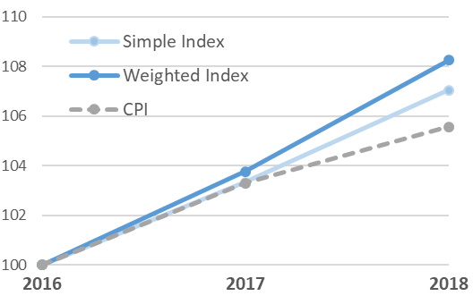
The Inaugural Qualifications Price Index Report
ALL QUALIFICATIONS
Notes:
Basket of 500 quals
Simple ave for GQ

Slide 22
The Inaugural Qualifications Price Index Report
Vocational & Technical
GCSE, AS & A Levels
Notes:
GQ figures still distorted by reform, AO involvement up, thus prices up
VTQ lower, 40% of prices in 2018 were flat – difficult trading conditions?

Slide 23
The Inaugural Qualifications Price Index Report

Slide 24
Ofqual update
Lucy Sydney
AO Forum, London, 14 May 2019

