Slide 1
End-point Assessment
Richard Mole
Education and Skills Funding Agency
14 May 2019

Slide 2
Today’s session
Update on Register of EPAO
Update on Apprenticeship Service
EPAO Readiness
Questions

Slide 3
End-point Assessment Dashboard
EPAO on Register
EPAO engaged to deliver
Apprentices with an EPAO
Certificates issued
227
147
231,125
+12,000
  We invite applications against 420 standards
  296 standards with an approved EPAO
  247 different organisations approved for the register
  +940 separate listings
Official
All data correct as of: 5pm 2 May 2019

Slide 4
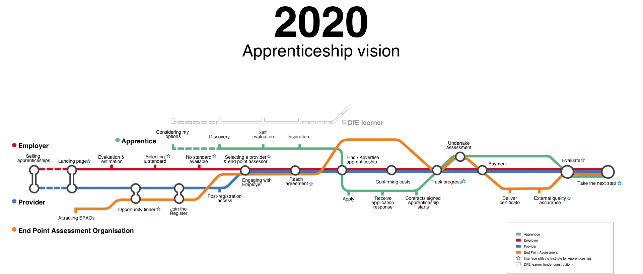
Apprenticeship Journey
Register processes
EPAO engagement
Certification Service

Slide 5
Apprenticeship Journey
Register processes
EPAO engagement
Certification Service
  New application process
  IFATE web link
  Improved content on Gov.uk
  Capacity analysis
  In principle work with Trailblazers

Slide 6
Apprenticeship Journey
Register processes
EPAO engagement
Certification Service
  Search / selection of EPAO
  EPAO agreement
  Payment for EPA
  EPAO ‘Home’
  Monitoring of apprentice progress
  ServiceNow access for EPAO
  Tracking and reporting of EPA activity

Slide 7
Apprenticeship Journey
Register processes
EPAO engagement
Certification Service
  Digital request process
  EPA feedback in apprenticeship service
  Info / data exchange with IFATE

Slide 8

Readiness and aligning with EQA
willingness or a state of being prepared for something:

Slide 9









Readiness
Working to improve demand forecasting
Application to the register
Readiness Checklist
Readiness discussion
Assessors and materials
Conditions & systems
Governance and quality
Compliant
Minor non compliance
Major non
Compliance
Critical non compliance

Slide 10


Top tips to support readiness – ideas from deep dive
Mentoring programmes
Collaboration
Monitoring
Communication
Case-studies

Slide 11


Slide 12
Keep in touch and up to date
  Contact us: apprentice.assessment@education.gov.uk
  Keep up to date:
  https://www.gov.uk/guidance/register-of-end-point-assessment-organisations
  https://www.apprenticeships.gov.uk/
  https://www.instituteforapprenticeships.org/apprenticeship-standards/
  Manage your digital account:
  https://assessors.apprenticeships.education.gov.uk/
  Set up web alerts on GOV.UK for our ESFA Digital Blog: https://sfadigital.blog.gov.uk
  Connect and promote apprenticeships
  Twitter Follow:@Apprenticeships, @FireItUp_Apps, @AmazingApprenticeships, @ESFAdigital
  LinkedIn Follow: National Apprenticeship Service

