Slide 1
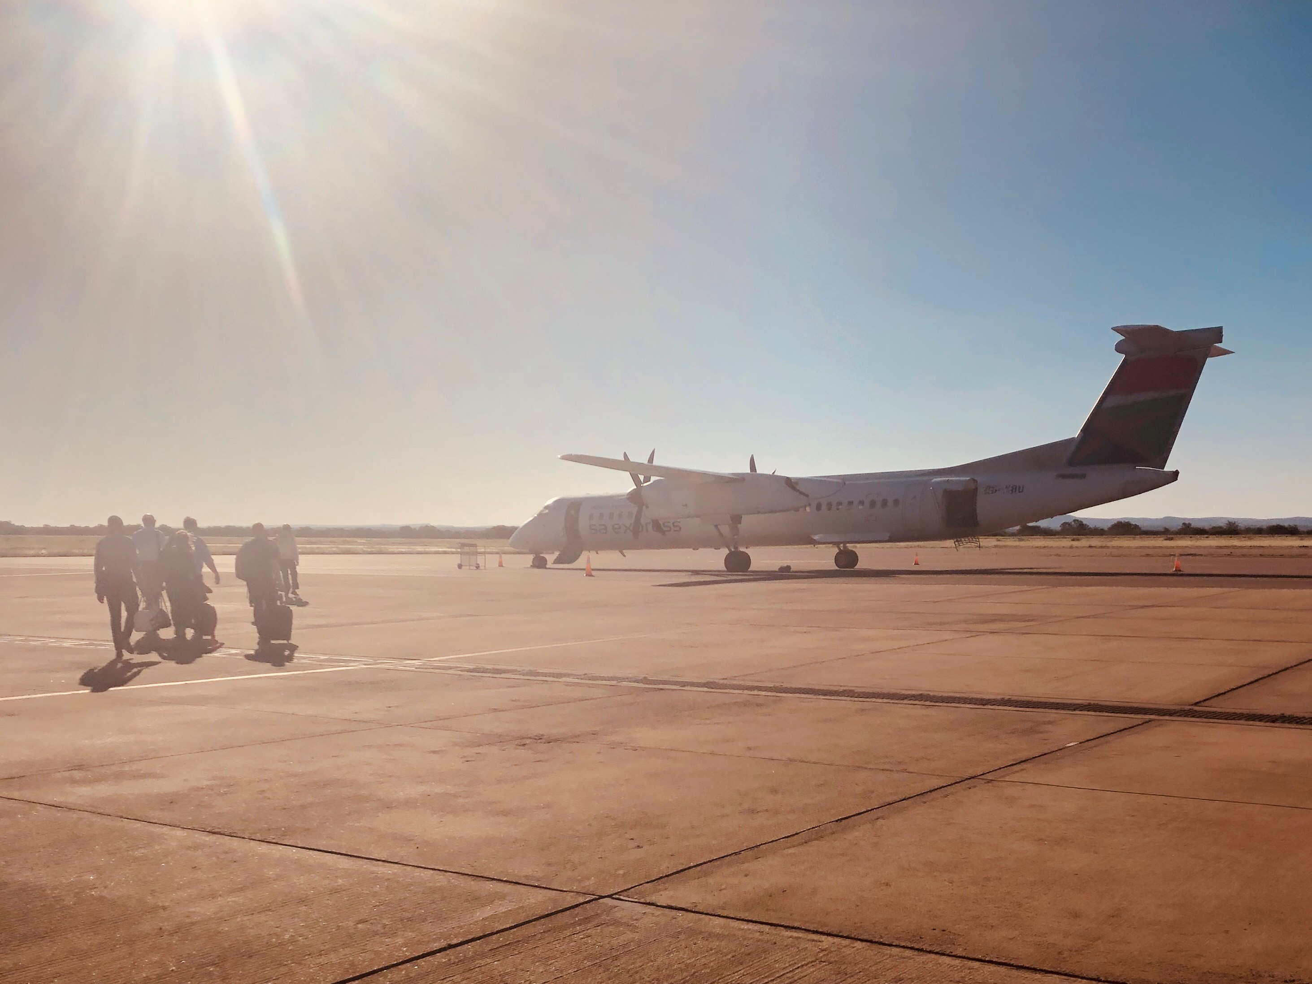


Building International Markets
Rob May
CEO, Association of Business Executives (ABE)
Chair of International Forum,
Federation of Awarding Bodies
robm@abeuk.com
@rob_may_

Slide 2
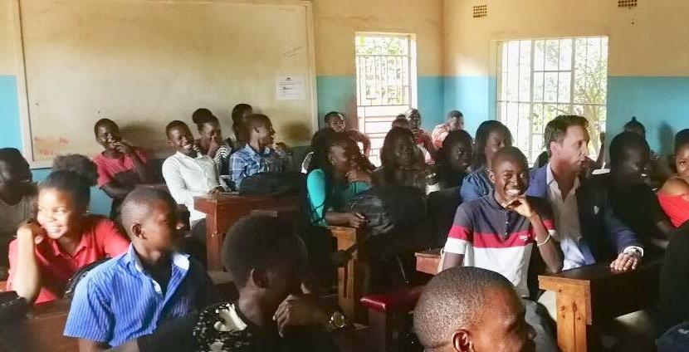

Global Britain – Global Skills
Which markets should you target?
Some considerations for entering and building a new market
How your trade body can help

Slide 3

Shift in the economic order
90% GDP growth outside EU
60% of world GDP from emerging economies by 2030
Massive global skills shortage
Government-led strategies and funding to boost economic reforms
UK will leverage global reputation to boost education exports to £35 BN by 2030.

Slide 4
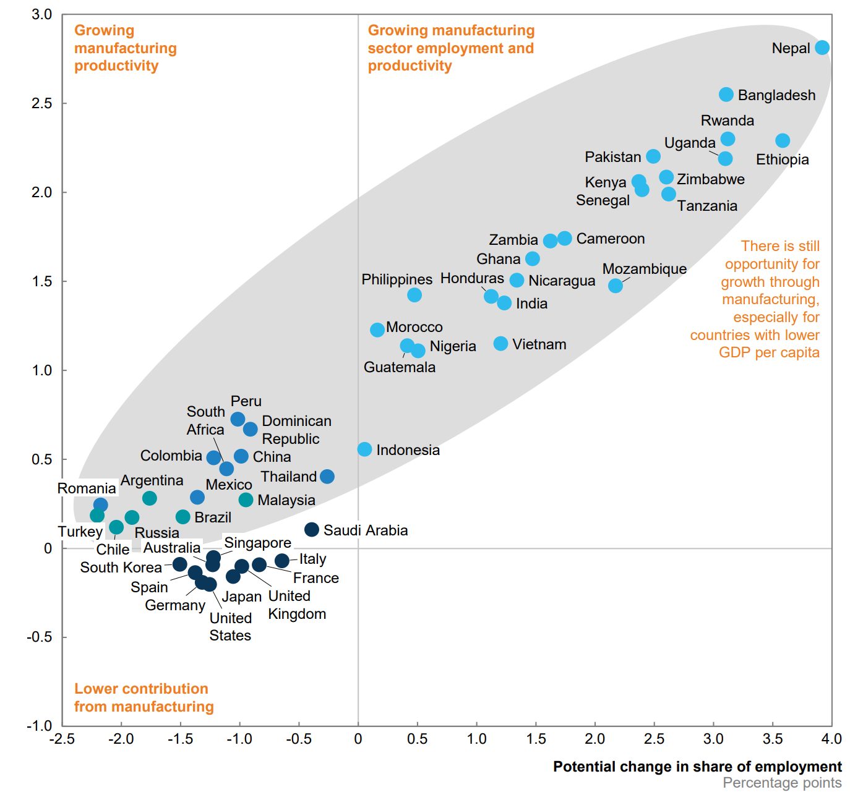
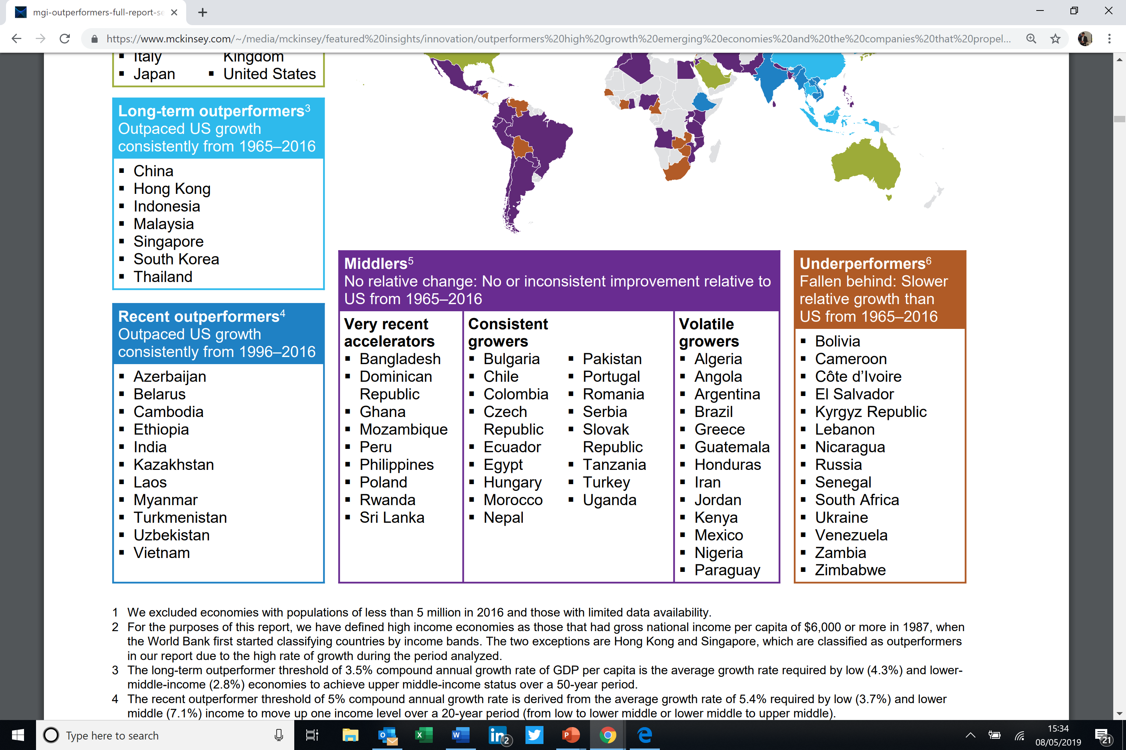
Economic reforms go hand in hand with education reform
When the uncertainty goes, so does the opportunity.
Source: McKinsey
Source: OECD

Slide 5



Research your market
Ensure a global-local approach
Lead with your social purpose
Be prepared to climb on a plane at short notice
Be patient and prepare contingencies
Use government support to unlock obstacles
Digital offerings are a factor
Reduce your learning curve!
Find strong partners and work together

Slide 6



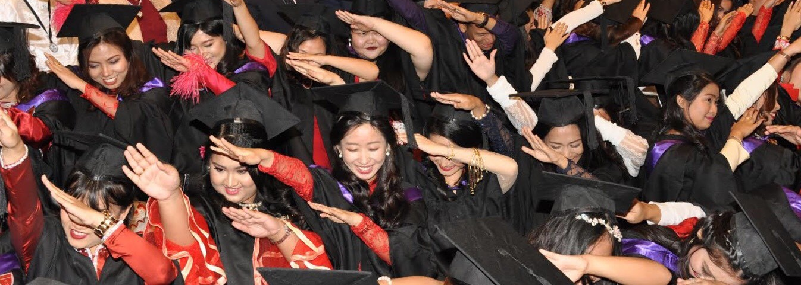
The International Forum aims to support all our members in a time of rapid change and promote the export growth and potential of the industry internationally.

Slide 7

Emerging economy market indicators all positive
British education brand is strong
Human capital challenges and skills gaps are a priority
Learning technology growing fast
Development funding is available
…Transform lives!
robm@abeuk.com
@rob_may_

