Slide 1
Developing a Simpler Skills System - IfATE's Role In Reforming Technical Qualifications to Meet Employer Needs
27 April 2023

Slide 2
Introduction
Carmel Grant
Deputy Director: Commissioning & Development – IfATE
This session will cover:
Increasing the quality of technical qualifications
The rollout of T Levels and Higher Technical Qualifications (HTQs)
The preparations for approving post 16 qualifications at Level 3 and below.

Slide 3
Post-16 reforms
The Skills & Post 16 Education Act puts the voice of employers at the heart of the skills system, empowering them to shape technical education qualifications.
Employers are key to identifying the skills learners need to be successful, and by listening to them we can improve the quality of the training and the opportunities for people to progress.
The development of employer led occupational standards have represented a major step change in the occupational relevance & quality of technical education. Not only are T Levels & apprenticeships based on these employer- led standards, but we are allowing for the development of new technical occupational entry qualifications (where there are no T Levels) against these standards.
We are working closely with Ofqual to develop one single approvals access point for technical qualifications, which will help awarding organisations navigate the system.

Slide 4
Level 4/5 reforms – Higher Technical Qualifications (HTQs)
The overarching aim of the programme is for higher technical education to be a high-quality, prestigious and popular choice.
HTQs are level 4 or 5 qualifications that have been quality marked by IfATE to indicate their alignment to employer-led occupational standards.
HTQs align to approved occupational standards and allow learners to enter their chosen profession or progress onto higher education.
We will raise the profile and understanding of higher technical education through a public campaign and improved information, advice and guidance. Work is also ongoing around funding, regulations and emerging skills.
https://www.instituteforapprenticeships.org/qualifications/higher-technical-qualifications/

Slide 5
Higher Technical Qualifications
"Higher Technical Qualifications (HTQs) are developed with employers, so you get the right training and skills you need to succeed at work. Watch Matty Chiabi and Sam tell us why this practical, employer-led qualification can help kickstart your career ⬇️ #GetTheJump
Higher Technical Qualifications - YouTube

Slide 6
HTQ Approvals Process
Pre-window
Application Window
Review & Consultation
Formal Feedback
Resubmission
Final Outcomes
Formal decision letter sent to applicants.
Where changes to applications are required for approval, applicants are informed and prepare to resubmit.
Consultation of experts through:
Peer reviews
Regulators & Professional Bodies
Route Panels
Applicants gather evidence and prepare their applications.
Applicants attend support sessions and workshops.
Final list of approved qualifications published.
HTQ team to support unsuccessful applications for next cycle.
Qualifications resubmitted with required changes and IfATE confirms approval.
If changes not possible, resubmission in next cycle.
Applicants submit all applications.
HTQ reviewed against criteria.
Occupational standard alignment
Regulator recognition & registration
Employer Engagement
Assessment

Slide 7
Level 2/3 reforms
We have launched a new employer-led process for approving Level 2 and Level 3 technical qualifications.
This will ensure that technical qualifications all deliver on employers’ skills needs by:
Applying our statutory tests to make sure content and assessment meets employers’ needs
Ensuring the system is coherent, rigorous, and streamlined to maximise quality and minimise bureaucracy.
Our new process will help ensure that the knowledge, skills and behaviours students learn are relevant and useful to employers. Making technical qualifications employer-led also produces best results for students who can feel confident they are learning the right skills for successful careers.
The first sectors under consideration will be construction and the built environment, digital, engineering and manufacturing, education and early years, and health and sciences. Awarding bodies will be able to submit qualifications for approval in summer 2023.
https://www.instituteforapprenticeships.org/qualifications/post-16-technical-qualifications/

Slide 8
Level 3, Cycle 1 Technical Qualification Categories
Aligns to occupational standard(s)
Builds on occupational standards
Category
Level 3 Occupational entry
(16-19 and adults)
Level 3 Occupational entry (adult only)
Level 3 Additional specialist (16-19 and adults)
Test(s)
Occupational outcomes test (Alternative approval test)
Specialist outcomes test (Additional specialist approval test)
Employer demand test
For additional support and resources please visit: Support and resources / Institute for Apprenticeships and Technical Education

Slide 9
Level 2, Cycle 1 Technical Qualification Categories
Cycle 1 categories
Funding
Level 2 qualification categories
Skills Act requirement
Occupational Entry: Quals delivering competence against an occupational standard (can be either extended or focused version of qual)
Aligns to occupational standard
Alternative approval test
Employer demand test and Ofqual conditions
Aligns to occupational standard
Alternative approval test
Technical qualifications
Primarily designed to support progression to skilled employment/ further technical training
16-19 and adult
Builds on occupational standard
Additional specialist competence test
Additional Specialist: Specialist technical qualifications
Cross-Cutting: Smaller technical qualifications offering transferable skills e.g. Health and Safety
Selectively covers occupational standard
Significant outcomes test
Adult only
Employer proposed: Quals delivering competence for occupations without a standard but where there is employer demand
No link to occupational standard
Significant outcomes test
For additional support and resources please visit: Support and resources / Institute for Apprenticeships and Technical Education

Slide 10
Evidence requirements from Awarding Bodies – employer evidence
Employer Demand
A clear rationale for employer engagement
Links to occupational standards
Evidence of direct engagement
Drawing on industry reports, skills plans and IfATE publications
For additional information please visit: Approvals categories and associated criteria and guidance​ / Institute for Apprenticeships and Technical Education

Slide 11
T Level overview
In 2020 we introduced T Levels as the new gold standard in technical education and the centrepiece of our reforms.
Summer 2022 saw the first cohort of T Level students complete their courses, with an overall pass rate of over 92%.
There are now 16 T Levels available, and we have 164 T Level providers across all regions of the country delivering. Data from these providers indicates that they have recruited around 10,200 new students to T Levels – more than double the 2021 figure.
There are well over 100 new providers planning towards delivery of T Levels in September 2023 and more that will commence delivery from 2024.
We are working with DfE to actively monitor the characteristics of students studying T Levels to ensure that T Levels benefit students from all groups.
https://www.instituteforapprenticeships.org/qualifications/t-levels/

Slide 12
T LEVELS: GET THE JUMP (Skills for Life)

Slide 13
T Levels
T Levels – the next level qualification – YouTube

Slide 14
T Levels
Industry placements – What employers say (YouTube)

Slide 15
T Level structure
T Level qualification
Approximately 1,800 hours over two years.
Students will need to achieve all elements to receive their T Level certificate.
Subject content is set by T Level employer panels, developed by Awarding Organisations (AOs), and approved by the Institute for Apprenticeships & Technical Education (“IfATE”). IfATE then oversees the delivery of the qualifications to providers by AOs.
T Level Industry Placement
Undertaken in an employer setting.
Minimum of 45 days, between 315-420 hours.
Students develop and apply their technical skills and knowledge in a workplace environment
Support for travel and subsistence costs is available but employers are not expected to pay students.
Technical Qualification (TQ)
Between 900-1400 hours and undertaken in a college- / school-based setting
Core Component
Up to half of the qualification
Knowledge and understanding of the concepts, theories and principles relevant to the T Level and the broader route.
Core skills relevant to the T Level.
Assessed through an external examination, and a substantial employer set project (ESP) undertaken in the classroom setting and set by Awarding Organisation (AO) employer panels.
Occupational Specialism(s)
At least half of the qualification
Knowledge, skills and behaviours required to enter employment in that occupational specialism.
Maths, English and digital competence integrated where relevant.
Students typically take one occupational specialism.
Assessed synoptically through rigorous practical assignments.
Other Requirements
T Level panels may set occupation-specific requirements, if they are essential for skilled employment, e.g. a licence to practise qualification or professional qualification.

Slide 16
Employer and Stakeholder Engagement
T Level panels help to put in place the framework required for an engaging and relevant programme for students.
The panels are employer-led, featuring leading industry names, meaning that the qualifications are constructed with the needs of industry firmly in mind.
As part of the development process, Awarding Organisations are required to engage with employers, providers and other stakeholders and provide detailed evidence of the impact these individuals have had on the development and validation of the TQ materials.
This approach means that employers are involved at every stage of the creation of technical education, from setting the standard, creating content and approving the qualifications that will be delivered. This is part of our ambition to deliver world-class technical education that equips young people to enter highly skilled occupations.

Slide 17
Ensuring T Level quality
DfE technical education reform programme / policy
Capital / CPD funding
Industry placements inc. funding
Results & certification
Ofqual regulation
Ofqual recognition
Ofqual review
Assessment oversight
T Level requirement identified
T Level Outline Content
Awarding Organisation Procurement
TQ development
TQ delivery
(inc. updates)
Route Panel views
T Level Panel input
Route Panel views
Route Panel views
Employer views
Employer views
Employer views
Employer views
Data / analysis
Provider views
Provider views
Provider views

Slide 18
T Level progression
Apprenticeships
Many T Level students will be able to move on from their course to a relevant apprenticeship at level 4 or above.
In some cases a student might want the opportunity to work in a different or more specialist area, which might mean taking an apprenticeship at level 3 or below. This would take into account the prior learning gained through completion of a T Level (while still needing to meet the minimum 12 month duration).
A T Level student would be able to move on to an apprenticeship at the same or lower level than a qualification they already hold, if the apprenticeship allows the individual to acquire substantive new skills and the content of the training is materially different from any prior qualification or a previous apprenticeship.
Skilled employment
T Level content has been designed by employers to facilitate direct progression into skilled employment.
Core content provides underpinning knowledge and breadth of skills to support adaptability.
Occupational Specialisms develop technical competence.
Industry Placement provides direct experience with employers, builds attitudes and behaviours and takes technical competence further.
Move to the next level
Further and Higher Technical Education
T Levels will provide a route to higher technical education at levels 4-6 such as Higher Technical Qualifications (HTQs).
Higher Education (HE) providers set their own admissions criteria. Discussions are ongoing with universities and other HE providers about the HE courses a T Level student would be suited for.
T Levels attract UCAS points, in line with A Levels. This will support progression into HE and help HE providers align T Levels with other qualifications in their offer.

Slide 19
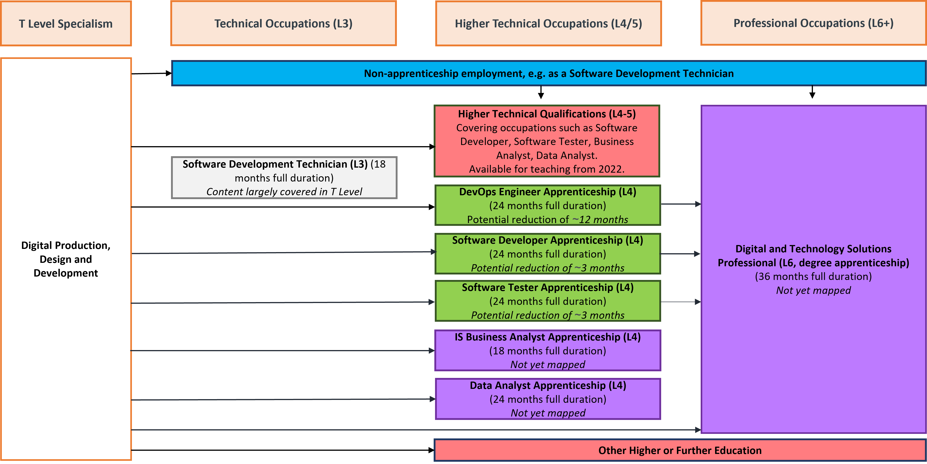
T Level progression
The progression profiles give providers, students, career advisors and parents a tool to discuss career options, whether that be supporting them to select the right T Level or to help them decide next steps after completing the T Level.
They indicate to providers and employers the areas a learner may need to develop following the T Level to reach full competence.
These are now embedded in IfATE’s new occupational maps.
DIGITAL PRODUCTION, DESIGN AND DEVELOPMENT:
Digital production, design and development
https://occupational-maps.instituteforapprenticeships.org/

