Slide 1
secure and confidential documents
Forward Thinking:
The Transformation of Print for Education
Tim Cammack Managing Director
SCD
Notes:
Good afternoon. My presentation’s objective is to get you to think a little differently about print in education and how it can be an enabler of a whole process of exam delivery rather than just a piece of paper with print on it.
TC
I’ve worked within the secure print industry for 31 years, the larger part within the education sector.
SCD has its print roots going back to 1836 based in Scarborough and have been involved in a wide array of print projects in the education world since the early 1990s.
It was formerly a subsidiary of Pindar PLC until 12 years ago.
We’ve worked with AOs ranging from
Universities, colleges, schools,
Professional bodies in finance, medical, health,
The Depts of education
International Ministries of Education.

Slide 2
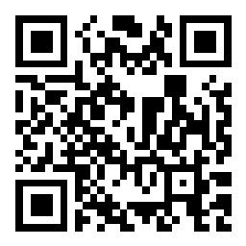
agenda
01
TRENDS
02
EXAMPLES
03
TAKEAWAYS
Join at slido.com #2481812
Notes:
I’m going to use a tool to get a little audience participation. So if you can get your phones out and scan this code and when prompted I’ll ask for your participation during the presentation.
While you’re setting that up, I’ve already introduced a piece of technology that the exam print world uses in multiple applications. The QR code or its counterpart, the barcode.
This helps me to help AOs to
Navigate to an ECert from a printed cert
Carries personal information on an exam answer sheet or book
Tracks an exam document moving through a production plant
Ensures that ALL items in an exam pack are collated and packed with 100% integrity
Tracks the package moving to and from a centre
Auto-captures data when scanning exam documents that are being returned.
More on this as we go.
The agenda:-
We’re looking at the transformation of print for education and what trends are we seeing in the assessment world for printed exams and certificates.
I’ll bring this to life with a few examples.
Finally some takeaways for you.

Slide 3
What words come to mind when you think of paper & print and the environment?
ⓘ Start presenting to display the poll results on this slide.
Notes:
POLL
If I take this piece of paper, I wonder if you can guess how much of this piece of paper will get recycled:-
The target by 2025 in the UK is 75%, 85% by 2030
In our industry and our experiences it’s probably already there and gone beyond
In examinations and a controlled and regulated environment we could be talking 10% or less is not being recycled.

Slide 4
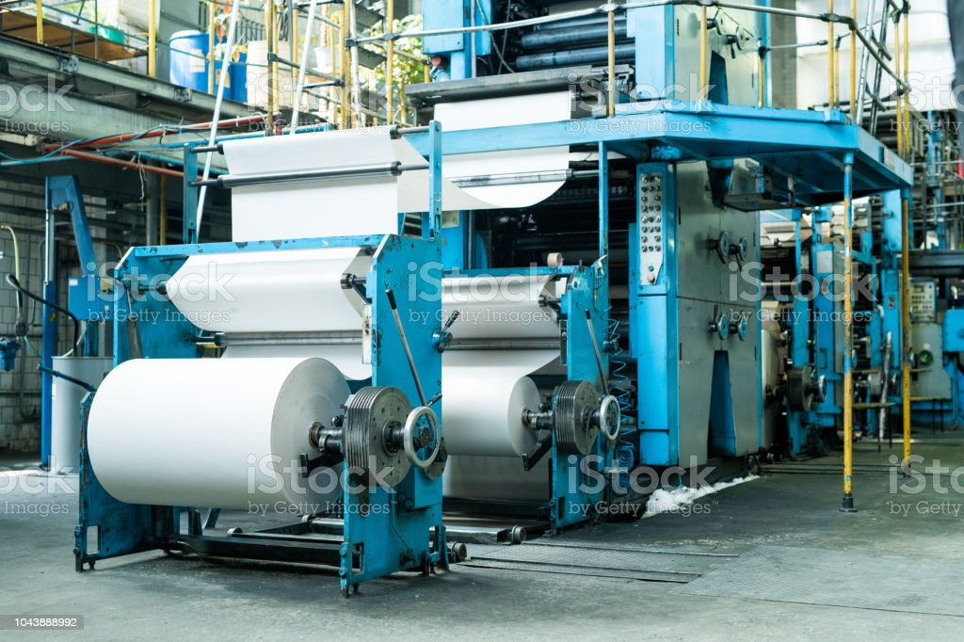
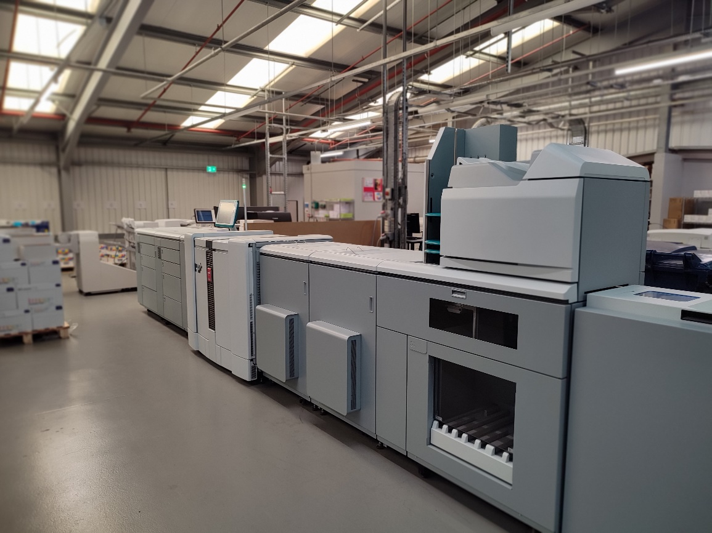
trends
01
ENVIRONMENTAL ISSUES
Notes:
So, it’s clear that technology is shifting and there is a move to online exams but for whatever reason (whether that be technology infrastructure, the testing environment, location or ease of set-up), it’s also clear that there is still a place for printed paper based exams and certificates.
These are the trends we are seeing from a print providers perspective.
Environmental Issues
The environment and energy are very topical subjects at the moment.
When I started my print career in the early 90’s, print was a heavy duty industry where there were lots of solvents, inks and chemicals involved
But this has evolved into a cleaner environment with great sustainability, low waste and low carbon footprint.
Lets bust a few myths!

Slide 5
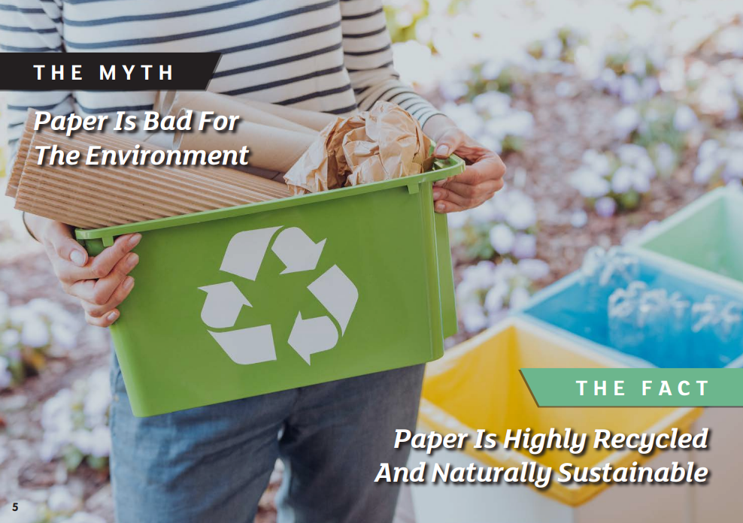
myths busted
Notes:
Paper can be recycled and re-used
Paper is based on wood, a natural and renewable material
“Go Paperless”, “Go Green” and “Save Trees” are common messages we experience,
…. but paper is a renewable resource, not like lithium and other precious commodities.

Slide 6
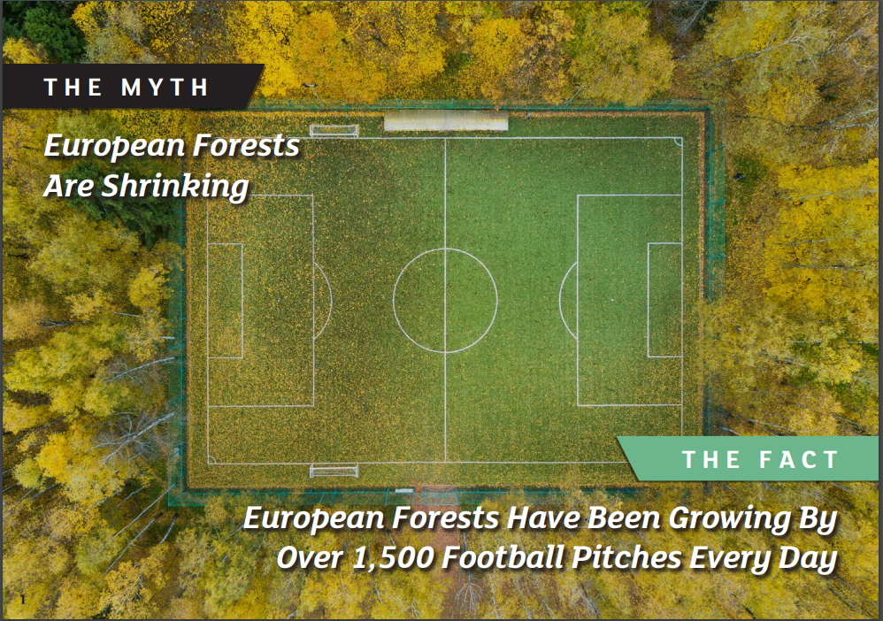
myths busted
Notes:
Forestry Stewardship within the industry demonstrates control of the supply chain that renews forests.

Slide 7
myths busted
Notes:
Paper and Print providers are working hard to reduce the environmental impact of production.

Slide 8
myths busted
Notes:
Conversely,
The ICT industry accounts for 5-9% of electricity use
This is more than 2% of global greenhouse gas emissions (as much as all air traffic).
European Commission, 2020 said “If left unchecked, the ICT footprint could increase to 14% of global emissions by 2040.”
Panorama did a programme a couple of months ago about the huge power resources needed to support data centres and cool immense data servers.
And E-waste is the fastest growing issue, a 21% increase in 5 years and recycling only at 42% in Europe.

Slide 9
trends
01
ENVIRONMENTAL ISSUES
02
ON-DEMAND
03
PERSONALISATION
04
OUTSOURCING
05
Traceability & Audit Trail
Notes:
On-demand
The pandemic saw an increase in demand for online exams and whilst online exams have grown, paper is still as popular today.
Within paper, what we’ve seen is an increase in faster turnaround and on-demand exams.
Not mass produced papers ….. printed as when needed
Print what you want when you want it…. And quickly.
Less waste and better environmentally
Digital paper libraries are created
Enables new papers to be created quickly and be readily available for distribution.
Retire old papers and replace instantaneously.
Open up back catalogues of small run papers.
Allow for language variants (Welsh for example).
Greater capacity and faster turnaround allows AOs to make a choice of how frequently to batch produce things and make cost savings.
Gone are the days of printing everyday just because we need to keep up.
Processes are quick and efficient and allow for personalisation.
That brings me on to another trend ….
Greater personalisation
We are seeing a greater need for papers to be pre-personalised which helps improve integrity, compliance and efficiency.
If there’s a name pre-registered, why not apply it onto their exam paper.
Also when looking at adapting papers for an individuals needs, we also see a greater requirement for more accessible papers
Over my time in this industry we’ve seen a significant shift in the way that people appreciate the use of modified papers for candidates with modified needs. Every test taker has different needs.
Equality, Diversity and Inclusion trends ensure fair treatment and opportunity for all – and we see this in a trend to accommodate EP, MLP and coloured paper etc.
To do all of this, you can’t really do it in-house as it’s not possible because of technology restrictions and this leads me to my next trend ...
Outsourcing requests
An outsourced solution can bring industrial power to a situation
An outsourced provider has already invested in all the technology that sits around design, personalisation, print speed and capacity, courier integrations and MI provision
Why have you got an expensive employee sat in a corner of the office printing certificates in a prime real estate location? Boxes of stock occupying expensive office space.
Staff may not be in the office. They may be working from home
They may be difficult to recruit and retain.
Secure, Trackable and Auditable Processes
With all this data flowing through and demand for regulatory control, there’s more requirement for auditable and trackable processes.
Can you instantly see where every order is, be able to report on it and audit it if required.
Data driven processes and a management system is good for
audit trail
Personalisation
Accuracy and integrity
Speeding up the turnaround time
Being more efficient and slicker
Our clients have said they know more about their processes through outsourcing than they did in-house as they have better MI and can then spend the time addressing the issues for continuous improvement.

Slide 10
CASE STUDYONE
Certificate Print and Fulfilment
Notes:
Lets look at some case studies. As an organisation we don’t speak publicly about our client names without authorisation so these are anonymised.
I make no apology.

Slide 11
case study 1
Certificate Print and Fulfilment
Outcome
Scenario
Solution
18 month backlog
No scaleable production
Centre/Learner demands
Crisis
Tight SLAs met
Confidence
Resource freed up to focus
Cost savings
Data driven workflow
Powerful software
Flexible labour solution
Notes:
#1 Post Pandemic Certificate Backlog – an AO in the college sector
Scenario
We were approached by the AO who due to the pandemic were unable to process physical certificates. They couldn’t get in the office and 18 months of certificates had been “satisfied” via ECerts.
In late 2021, centres and learners were demanding their physical certs and asking when they’d get them.
This was a problem for the AO to fulfil that volume of certificates..
Solution
A data driven workflow process
Powerful software that maps the inputs (i.e. data and certificate overprint templates) to the outputs (i.e. print files, courier labels, production check sheets) and incorporates the business rules from the data (i.e. what order in which items are printed, when to add partner logos onto documents)
A team of people that can meet labour demands through flexible working practices
Outcomes
Backlog cleared in a very short space of time at the AOs pace.
SLAs met and beaten consistently and reliably. SLA is next day dispatch but we tend to norm on same day.
Confidence in turnaround, accuracy and integrity is high – it’s not something they question and they build on this.
Our familiarity with their project spots their errors before they happen – we have become a safety net and a safe pair of hands.
So happy they decided the solution was worth continuing after the bulk production had been dealt with.
Key individuals are freed up to deliver better outcomes for the AO – customer service, regulation, quality.
Less frequent batching delivers real cost savings – we hit it harder and quicker.

Slide 12
CASE STUDYTWO
On Demand Exam Print and Distribution

Slide 13
case study 2
On Demand Exam Print and Distribution
Outcome
Scenario
Solution
Non-scaleable
Not integrated
Needed design flair
Tight SLAs
SLAs met
Integrated process
Full Audit Trail
Confidence
Data driven process
Personalisation
Extensive RA provision
Courier Integration
Notes:
Scenario
A very ambitious AO who recognised the need to grow. They were handling around 150k tests per annum to give some context.
My perception when reviewing their processes was very much a “cottage industry” approach – it was very tailored, very precise but not scaleable
They printed everything in-house – but there was little back-up
Systems weren’t integrated – a little disjointed. Nonetheless they worked but would creak with more volume.
The look and feel of their papers lacked a little design flair. Created in MS Word and looked it.
SLA turnarounds were also tight – particularly in the delivery of RAs
Nonetheless they knew they needed to adapt to grow.
Solution
Again data driven process – an automated daily data file that flows straight from their systems directly through to our production, packing and dispatch via a management system.
Personalisation – if we have a name pre-registered, we put it on. If not, leave blank and capture after the exam. Very pragmatic.
Adapted to incorporate all their reasonable adjustments (MLP, EP, Coloured papers). And this AO is very ambitious in this area
27 variants of coloured paper
Centres can place modified requests 10 working days prior to exam date
and none of this “ we’ll send you a file and you can print it yourself”. Modifieds are provided and with personalisation as well.
That takes a well oiled machine to deliver.
Outcome
Tight SLAs met
Print what you want when you want it…. and quickly.
A very integrated process with full audit trail
With any new implementation you’re always very alert and aware in the first few days, even with extensive testing and trialling.
We had a centre on day 3 after Go Live who checked their exam papers on the eve of the exam at around 5pm and declared that there were missing modified large print papers. In this scenario the natural approach is to rectify the issue first and investigate second. By 7pm we’d re-printed the pack, and dispatched for early delivery next day.
Crucially though we were able to provide an audit trail from the pack weight that demonstrated that the papers had been packed and dispatched originally and been mislaid by the centre.
The AO retains total control of process without the pain as all this MI is being played back via an online tracking portal for the Customer Service teams to be able to use..
Customer feedback on delivery issues has been that they’d never seen so much detail before in terms what the delivery issues were – they were hidden because they didn’t have the MI circulated..

Slide 14
final takeaways
Outsourcing brings greater control of the process
Insert your desired text here.
Insert your desired text here.
Quicker processing - reduces cost and waste
Greater personalisation improves learner experience
Insert your desired text here.
Paper is a technology and thriving
Insert your desired text here.
Notes:
1. Outsourcing if done right doesn’t mean you lose control.
AOs find they end up with more control, better MI and can then focus their teams on delivering better performance in real AO tasks elsewhere.
2. Quicker processing can be achieved that reduces cost and waste. Are there processes in your organisations that could be digitised – could you leverage on our investments in this area to help?
Speed up
Reduce cost
Free up valuable resource
3. Greater personalisation can improve the learner experience.
4. Paper is a technology and thriving. Using modern digital and digitised techniques provides the cutting edge of technology. I’m seeing paper exams thriving because we’re making more use of tech and were working alongside online exams. It’s very adaptive and customisable and can help drive the exam process.

Slide 15
final thought
On your 100th Birthday, you’d be disappointed if the King only sent you an email.
Notes:
On your 100th birthday, you’d be disappointed if the King only sent you an email.
Certificates are a tactile and treasured piece of paper. They engage learners. They are commemorative documents that reward learning. ECerts do have a role to play but can remove that personal touch and connection.
I have an Ops Manager who swore blind he’d never study again after his L5 in Business Management. Throw a hat in the air and give him a bit of paper and he was re-invigorated to take on the L7.

Slide 16
Which trends are you seeing within your educational world?
ⓘ Start presenting to display the poll results on this slide.
Notes:
My exit poll.
I’ll take questions whilst people submit their response.

Slide 17
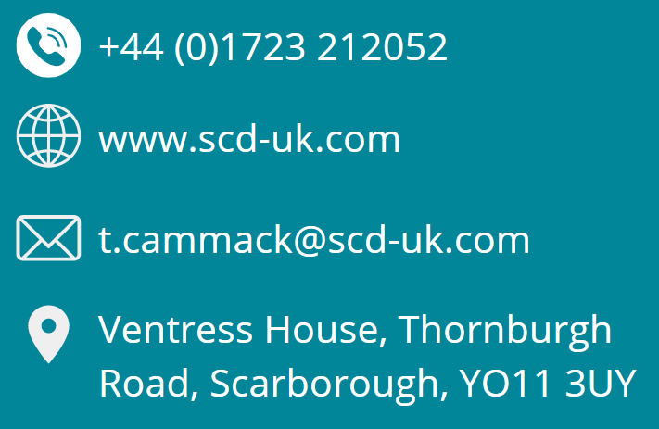
thank you
Contact us to find out how we can help you transform production and distribution of certificates and exams.
www.calendly.com/tcammack
Notes:
Thank You
I’m around after the event to talk about a potential investigation into a project
but if you need to get away please feel free to get in touch
I doubt many of you have stepped foot in a modern print environment recently so there’s an open invitation to visit our operation and see it working first hand.

