Slide 1
Ofqual’s regulatory approach and priorities Claire McCann, Associate Director, Awarding Organisations Engagement

Slide 2
Coming up…
Introducing Ofqual
What we regulate
Ofqual’s regulatory approach
How we keep Awarding Organisations up-to-date
Key considerations for Ofqual
Ofqual’s regulation of end point assessment

Slide 3
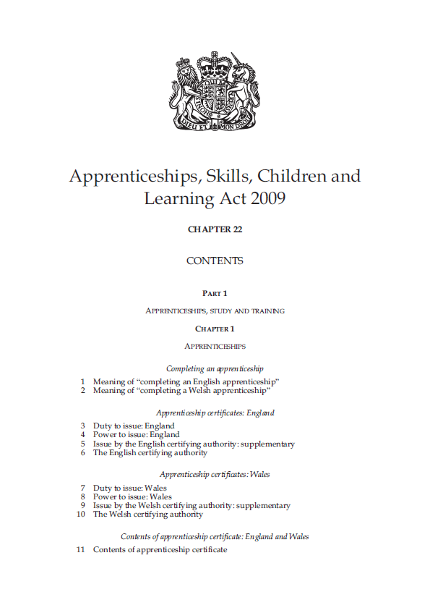
Introducing Ofqual
Independent, expert regulator of qualifications and assessments in England
We have five statutory objectives:
Secure qualifications standards
Promote National Assessment standards
Promote public confidence
Promote awareness
Secure efficiency
We must consider stakeholder requirements for qualifications and assessments, including those from the sector and industry

Slide 4
Introducing Ofqual
Regulated qualifications reliably indicate the knowledge, skills and understanding a student has demonstrated
Assessments and exams show what a student has achieved
People have confidence in the qualifications we regulate
Students and teachers have information on the full range of qualifications we regulate
Ofqual’s work means:

Slide 5
Introducing Ofqual – strategic priorities
1. Quality and fairness for students and apprentices
2. Clarity, effectiveness and efficiency in the qualifications market
3. Shaping the future of assessment and qualifications
4. Developing Ofqual as an effective, expert regulator and inclusive employer

Slide 6
What we regulate
235 awarding organisations, 37 of which were recognised in the past year
16,009 certifiable qualifications available to new learners
588 approved EPA standards

Slide 7
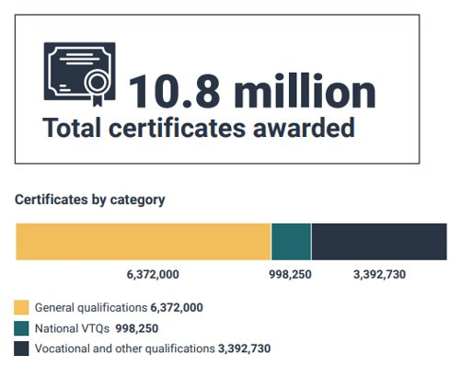
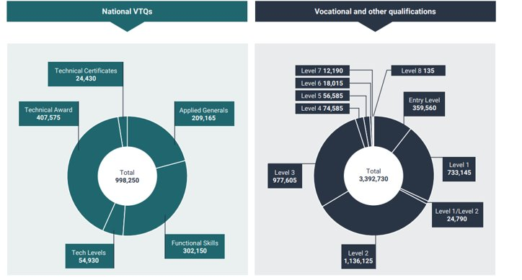
What we regulate
2020-2021 certifications

Slide 8
Ofqual’s regulatory approach
Ofqual:
controls entry to the regulated market
creates rules and provides guidance for AOs to help ensure qualifications are fit for purpose, valid and delivered securely
sets requirements that AOs must always meet, monitoring compliance and taking necessary action
takes a co-regulatory approach

Slide 9
How Ofqual keeps Awarding Organisations up-to-date

Slide 10
How Ofqual keeps Awarding Organisations up-to-date
The Portal
VTQ Regulator’s Briefing
Knowledge Base webinar series
Attending events like this

Slide 11
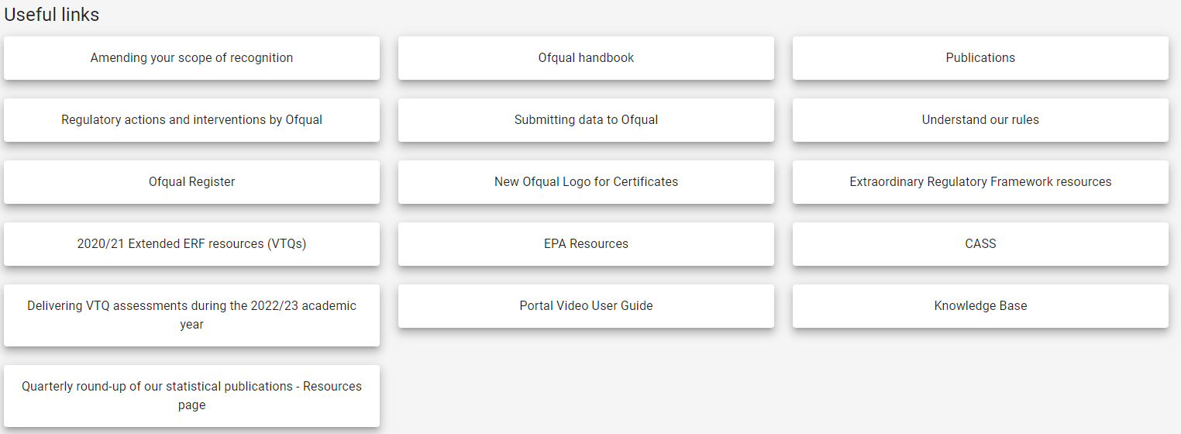
How Ofqual keeps Awarding Organisations up-to-date
The Portal – news, inbox, APQs, links

Slide 12
How Ofqual keeps Awarding Organisations up-to-date
VTQ Regulator’s Briefing
Normally chaired by Executive Director Catherine Large
Covers strategically important updates relevant to our VTQ community
Normally takes place every other month
Next one is on 16 May – sign up soon!

Slide 13
How Ofqual keeps Awarding Organisations up-to-date
Knowledge Base webinar series

Slide 14
How Ofqual keeps Awarding Organisations up-to-date
Knowledge Base webinar series
Examples include:
Induction presentation
Event notification best practice
Keeping your business secure – including advice from the National Cyber Security Centre
Designing and developing accessible assessments
Meet the VTQ Field Team

Slide 15
Key considerations for Ofqual

Slide 16
Key considerations for Ofqual
Ensuring students receive accurate results on time this summer
Ofqual has published a statement of measures to ensure correct and complete results are issued to Level 3 VTQ students in summer 2023
Three new deadlines to ensure that AOs in scope issue complete and correct level 3 VTQ results to students
AOs will collect and maintain details of a senior designated contact in schools and colleges who is responsible for exam delivery
AOs will work with UCAS to track students applying to higher education
Ofqual has launched a new VTQ Information Hub
AOs are working to ensure their communications to centres are clear and targeted

Slide 17
Key considerations for Ofqual
Important housekeeping for all AOs
We are asking all AOs to help protect students by:
being vigilant to increased risk of fraud
adopt robust IT processes
assess your financial controls
review contingency plans
considering the risk of centre insolvency
have appropriate mitigations in place
consider the impact on students
helping students progress by making sure they receive qualification certificates promptly

Slide 18
Key considerations for Ofqual
Innovation
Ofqual’s corporate plan shows our commitment to working with AOs to develop an innovation service
In February, 28 people from 16 AOs took part in a workshop to help shape the service
Key themes from the workshop
Importance of clarity and simplicity in the design of the service
Timing is crucial
Willingness to find the balance between commercial sensitivity and sharing
We will be in touch via the Portal to explain next steps for developing the service

Slide 19
Key considerations for Ofqual
Artificial intelligence – challenges and opportunities
ChatGPT is a powerful language generator developed by OpenAI.
It is trained on a huge dataset of text (eg books, articles, webpages)
Language models, such as ChatGPT, are statistical predictors of word sequences
There is no understanding or intent behind their outputs
The model learns patterns and relationships in the dataset and generates text similar to the text on which it trained
To generate text, the model uses the context from the prompt to predict the next word in the sequence, one word at a time
The process is repeated until the desired number of words is generated

Slide 20
Key considerations for Ofqual
Artificial intelligence – some of the things to think about
Item writing: possibilities and risks
Marking: possibilities and risks
Bias, ownership and security
Use in assessment/ student malpractice

Slide 21
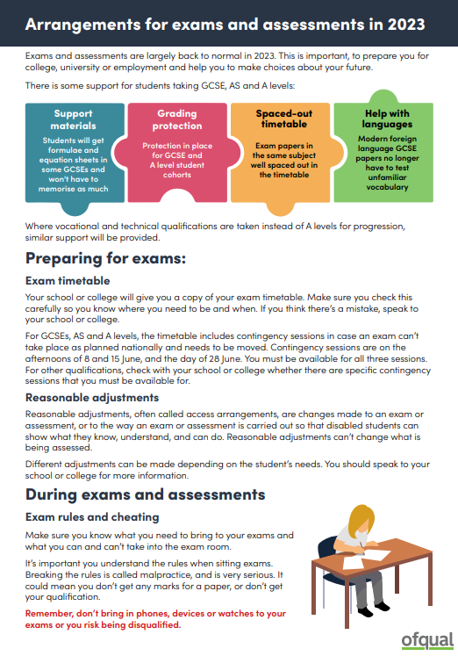
Key considerations for Ofqual
Providing students with helpful information
Ofqual Student guide has been refreshed and revised ahead of summer assessments – please share with colleagues and centres
For students taking VTQs taken alongside GCSEs and A levels, including BTECs, Cambridge Nationals and Cambridge Technicals

Slide 22
Key considerations for Ofqual
Designing and developing accessible assessments
Last May we published guidance for designing and developing accessible assessments, particularly written assessments
AOs should be able to demonstrate how assessment materials commissioned since 12 November 2022 reflect this
We are monitoring how AOs have responded to the guidance and evaluating how it has impacted your design and development processes
We will use the outcomes to:
decide on further monitoring/evaluation activities, if appropriate
inform further guidance, if applicable
share good practice with all AOs
We will publish further details on the Portal
Do you have thoughts on guidance to support designing/developing accessible practical, performance-based, digital/remote assessment or use of assistive technology in assessment? Email us: strategicrelationshipsgq@ofqual.gov.uk

Slide 23
Ofqual’s regulation of end point assessment

Slide 24
Ofqual’s regulation of end point assessment
Simplified system, moving from multiple EQA providers to two statutory regulators
Integrated degree apprenticeships
The majority of apprenticeship standards

Slide 25
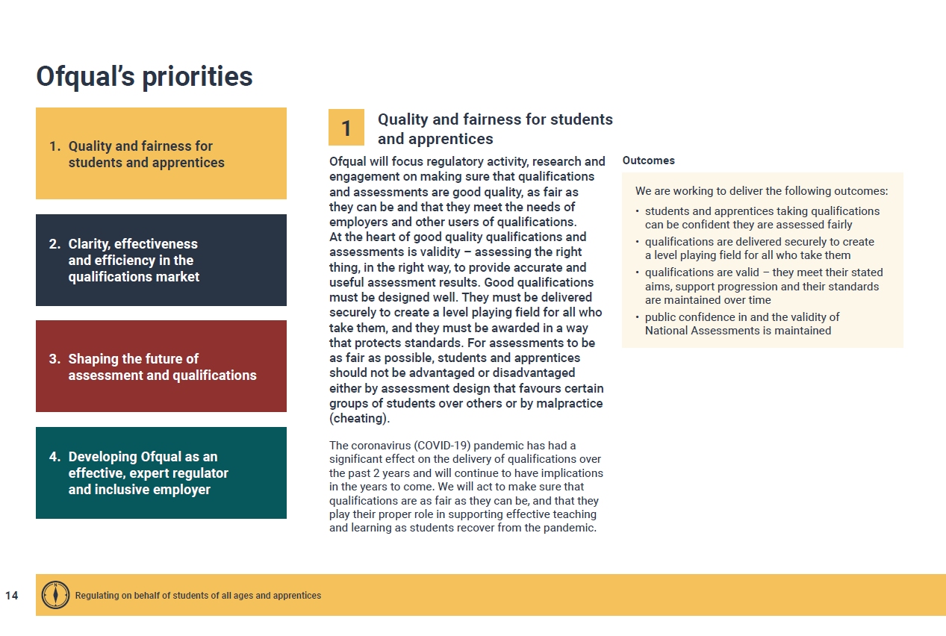
Ofqual’s regulation of end point assessment
Validity - assessing the right thing, in the right way, to produce accurate and useful assessment results
“At the heart of good quality qualifications and assessments…”

Slide 26
Ofqual’s regulation of end point assessment
A guide for awarding organisations
Ofqual regulates EPA by:
controlling entry to the regulated market
creating and maintaining the rules AOs must follow
targeting our regulatory resources appropriately
investigation and enforcement activity
Ofqual regulation of Apprenticeship End-Point Assessment: a guide for awarding organisations - GOV.UK (www.gov.uk)

Slide 27
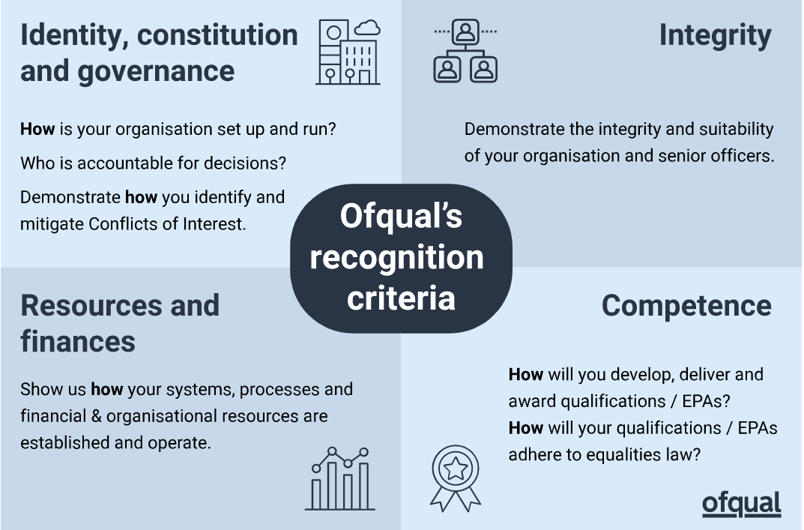
Ofqual’s regulation of end point assessment
Recognition process
Any organisation that wants to deliver regulated EPA must gain Ofqual recognition
Ofqual regulation of Apprenticeship End-Point Assessment: a guide for awarding organisations - GOV.UK (www.gov.uk)

Slide 28
Ofqual’s regulation of end point assessment
Monitoring EPA - Ofqual
monitors AOs’ overall capacity, capability and governance
monitors AOs’ qualifications and assessments, checking delivery at multiple points
undertakes thematic monitoring, identifying risk early through intelligence gathering and sharing
Ofqual regulation of Apprenticeship End-Point Assessment: a guide for awarding organisations - GOV.UK (www.gov.uk)

Slide 29
Ofqual’s regulation of end point assessment
Ofqual’s approach to monitoring EPA
Apprenticeship standard and assessment plans
Technical evaluation
Live observations
EPA forums
Information and data collections
Statement of compliance
Audit work
Ofqual regulation of Apprenticeship End-Point Assessment: a guide for awarding organisations - GOV.UK (www.gov.uk)

Slide 30
Ofqual’s regulation of end point assessment
Communications
Regular flow of communications
Portal
VTQ Regulator’s Briefing
Ofqual regulation of Apprenticeship End-Point Assessment: a guide for awarding organisations - GOV.UK (www.gov.uk)

Slide 31
Thank you

