Slide 1
Following the evidence trail
Sarah Edmonds
(Artemis Associates Consultancy Ltd.)
Notes:
I have had the privilege to work with many of you in the room – always a privilege to be trusted with the inner workings of an org – warts and all… because we all have them: policies we know need revising, processes that don’t flow well enough, systems that need investment, custers that are a little… intransigent?
We thought the most useful time for this session should be spent sharing my 9bservations on issues which I have found most common and applicable regardless of the type of AO/EPAO you are – the best takeaways if you like.
To my clients past and present – don’t worry: nothing identifiable here!

Slide 2
Gordon Associates forum
Today’s observations are based on:
4 years of consulting (but over 20 yrs as an AO professional)
Working with 20+ organisations, mostly AOs and EPAOs
Recognition
Compliance and regulatory action
SoC and thematic audit support (conflicts of interest/CASS)
Policy and strategy development
Assessment design, standardisation and training
Malpractice
Notes:
To my clients past and present – don’t worry: nothing identifiable here!
First a show of hands:
• AOs who are EPAOS?
• AOs with funded quals affected b the ongoing L2 and L3 qual reviews
• AOs as professional bodies
• AOs working in HEI space too?
• International market?
• Who was part of Ofqual’s CASS testing?
• All/none of the above?!
Im asking these Qs as obviously not everything I will cover is relevant to everyone… we live in interesting times in this market place… there is a levelling out (if not up!) and some acquisitive events: AQA – Alphaplus TQUK, AIQ to NCFE, ABE to ILM – the generalist becoming specialists!

Slide 3
The single truth
If you say you have it, or say you do it…
…the regulator will ask for it
Notes:
There is one single truth that has always been evident with regard to audit regulation: if you tell Ofqual that you do something, or have something, they will hold you to it and ask you for it; if you didn’t have it, or weren’t doing it, then don’t hurriedly create it for them… they will call you on it by checking dates of creation/ implementation. If it is a system that is at an early stage (eg UAT) running alongside an existing process – be honest. Don’t wait for them to spot gaps – they will take greater comfort from the fact that you are able to recognise your own risks in relation to compliance… the confidence they seek is that you not only understand the GCOr, but how they relate to your org’s existing infrastructure, resources, ways of working etc and therefore where your risks are.

Slide 4
COnsistency
The 4 “P”s:
People
Policy
Product
Process
Notes:
Consistency is key: how do you apply consistency of approach to all your processes relating to the lifecycle of your qualifications (or assessment lifecycle as Ofqual has been calling it for the last 4 or so years) – write it down: SOPs/NOPs, handbooks, something I have called – and I see others now using – the 4 Ps: products, People, Policies, Processes… the last is this. Makes for a great reference point for auditors, makes for great consistency internally and… BCP for succession planning. It is this that appears to be the greatest variant between AOs

Slide 5
How do I ensure consistency of approach (in all things?)
By department?
Tied to our risk management policy and strategy?
Designed against the assessment lifecycle?
Mapped to the Conditions/Principles of recognition?
Notes:
You need to decide how to do it – by dept? Tied to risk strategy? Design against the lifecycle or mapped to conditions? I would steer away from pinning it to CoR as it should be part of any business innfrastructure and regulators are keen on remindindg you they DON’T tell an AO HOW to run its business

Slide 6
The missing link?
The process… is it written down?
Notes:
A SOP really is the missing link: it allows any reviewer to follow the breadcrumbs or the paper trail and enables the AO to fulfil the obligation of “evidence not promises” as the good SOP will lead you to the right outcome: generating the evidence.
It is easy to find out if you have the right processes in place: I frequently ask a client to describe something “talk me through how you decide to develop and offer a new qual?”; explanation follows, I follow up with “where is that written down?”

Slide 7
However… the obvious flaw
Which comes first? The chicken or the egg?
Create the process…?
Have the process reflect what already happens…?
Either?/both?
Don’t create museum pieces
Notes:
There are obvious flaws in this too – important to keep under review: reflective of what ACTUALLY happens (don’t steer your activity to the SOP, ensure the SOP is written around how the activity actually occurs! Things and people do change/leave – it’s ok change, adapt remove (think of scale of change in tech systems CRMs etc) but also remember tacit knowledge exiting the building – RISK!
In summary for this point, a good SOP should be able to triangulate all four Ps – the “thing” it relates to, the ppl responsible for execution, the policy/s in the framework it comes under and the system for locating, storing/retrieving etc ie where to find and do this stuff…
Where and how you create and record is up to you – a centralised platform is best, but Word/Excel does work but carries greater risk of version control, getting lost, issues with individual access and human error

Slide 8
A5: capacity and capability
(resourcing your business)
Notes:
Onto other observations and potential learning
Probably the most common condition that had “holes” in it for several AOs: A5
A5.1(a) ensure that it has the capacity to undertake the development, delivery and award of qualifications which it makes available,
A5.2a Workforce of appropriate size and competence, (b) retention of data which will ensure that adequate information (d) appropriate management resources, (e) planning and internal control. 5.3 (a) regularly review its ongoing resource requirements and make appropriate changes to take into account the findings of each review,

Slide 9
The “holes” in resourcing
Malpractice: design (capability), investigation (capacity)
Event notifications: capability (and capacity, if you are a big business)
Horizon scanning: policy and interpretation/impact (good governance)
Poor succession planning
Impact of external policy change due to intrinsic competence: grading models, assessment strategies, blueprints and mark schemes
Notes:
For the purposes of:
• Preventing and investigating malpractice
• As above but for event notifications
• For horizon scanning – policy developments and how they impact: who does this and how? And how do they report their interpretations and findings? THi is good governance!
• Impact assessment on key staff exiting
• And finally for many VTQ AOs, the emergence of a more substantial approach to grading models, performance banding, creation of assessment strategies and blueprints. Many AOs who are less than 10-15 years old may still have a “QCF” approach to qual development and perhaps lack the organisational history of assessment development that is anything other than the mastery model of a binary competent/NYC approach.

Slide 10
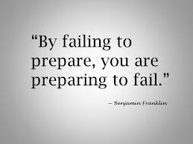
More on malpractice…
Good understanding:
Detection
Following up suspicion
Reporting and recording
investigating
Noticeable gaps
Understanding of prevention
Early on – at design stage
Where are the threats here?
Are we reacting or looking ahead
Notes:
Final observations and the constant ongoing concern of malpractice prevention: just delivered both bespoke and for FAB – heavily end-loaded understanding ie QA, obs, sampling, assessor vetting etc (good understanding of CoI – so there should be based on the focus Ofqual give it!) BUT, how to design it out is much thinner

Slide 11
And finally
…and somewhat inevitably
Notes:
And finally – anyone went to BETT? Digital assessment supplier-rich environment (although I still took home a LOT of paper!)
I have to comment on the now obligatory topic of Open AI and chatGPT. Lean in, don’t ignore, get informed, follow the grown ups (Daisy Christodoulou, Steve Altman’s own YT talk, JCQ’s questionable policy , e-assessment assoc conf, those suppliers wo are agile and already developing – ask yours!!

Slide 12
Notes:
https://www.bestcolleges.com/research/college-students-ai-tools-survey/

Slide 13
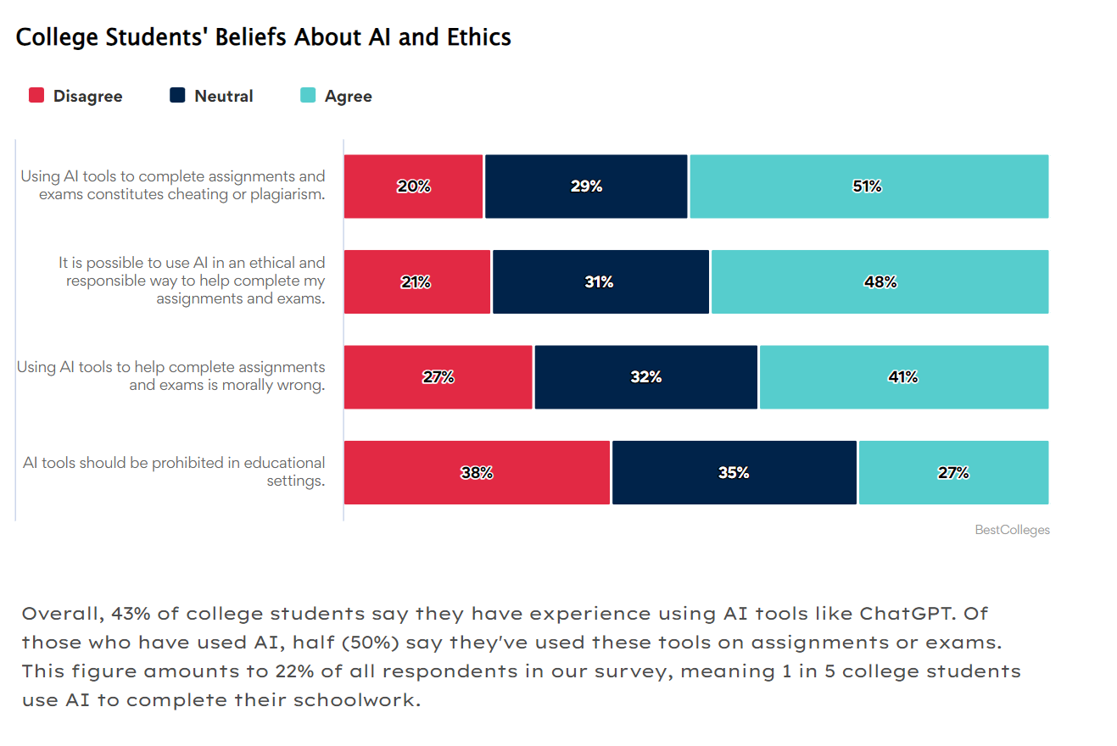

Slide 14
Thank you
www.artemisassociates.co.uk

