Slide 1
Unlocking International Opportunities
Bridging Borders Through Qualifications

Slide 2
Gateway to Success
Why? Opportunities for diversification & growth
Beware! Challenges & pitfalls in working with a global audience
How? Key strategies & considerations for providing qualifications & content to an international market
Notes:
Also, a case study of our own journey. We’re no experts but we have learned a lot along the way and are of course still learning.

Slide 3
Our Why Active IQ’s Sustainability Strategy “Healthy People, Healthy Planet”
Aim was to become a more sustainable business with an emphasis on social impact:
Financially
Operationally
Environmentally
With alignment to the UN Sustainable Development Goals, with a particular focus on:
Good health & wellbeing
Quality education
Decent work & economic growth
Responsible consumption & production
Climate action
Partnerships for the goals
People, Planet, Profit
Notes:
Part of Active IQ’s motivation for international expansion.

Slide 4
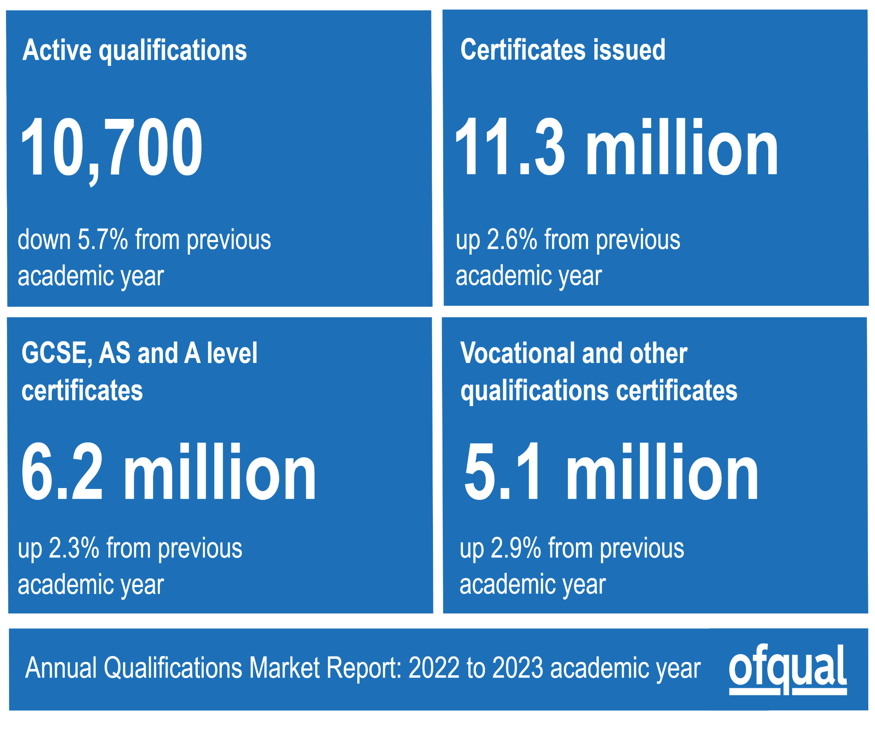
Why? The Qualifications Landscape
Number of certifications of regulated qualifications awarded outside the UK
Year | Number of certificates
2019 to 2020 | 4,880,120
2020 to 2021 | 5,776,325
2021 to 2022 | 6,732,000
2022 to 2023 | 8,552,050
22/23 academic year up 27% on PY
Notes:
The international market is growing, and Level 1 regulated qualifications had the highest number of certificates issued outside the UK in the 2022 to 2023 academic year, accounting for 38.7% of the non-UK total. However, active qualifications are in decline and the growth of vocational qualifications is only showing a low level of growth.
All qualification levels saw an increase in the number of certificates issued outside the UK in the 2022 to 2023 academic year compared with the 2021 to 2022 academic year. Entry Level regulated qualifications saw the largest proportional increase and the largest increase in the raw number of certificates issued outside the UK, up by 66.5%, equivalent to an increase of 797,100 certificates compared with the previous year.

Slide 5
Why? Borders not Barriers
Demand for UK quality vocational and technical education is on the rise
AOs have a wealth of existing content and expertise
Impact of the pandemic in breaking down borders
The need to create more sustainable business models
An opportunity to share and learn
Attractive proposition for acquisitions and mergers

Slide 6
Why: Opportunities for Diversification & Growth
Awarding Market
EPA Market
Sustainability
Demand for UK Education
5.6% decrease in active qualifications from 21/22 to 22/23
VRQs down 8.8% from 21/22 to 22/23
251 AOs in 22/23 compared to 160 in 18/19 (79 for EPA only)
Highly regulated, saturated market
Highly regulated market
Heading towards saturation? (121 AOs 2022/2023)
Funding reliant
High delivery costs
Is your business model sustainable?
What is your commitment to CSR?
Are you future proofed?
Do you need to de-risk?
Demand for UK quality vocational and technical qualifications is on the rise
Regulated and non-regulated
Credibility and assurance
Notes:
Leisure, Travel & Tourism down -0.7% in 22/23 from 21/22 which is obviously relevant to Active IQ.

Slide 7
Our journey so far…
European Funded Projects
Global Registers
Organic Growth
Internal Expertise
Strategic Growth
Trade Missions
Events
Partnerships
Notes:
EFP: Development of European Standards for EHFA; Development of EHFA Accreditation Process; Development of eLearning Content aligned to standards.
Global Registers: Europe Active/EREPs; REPs Ireland, ICREPs.
Organic Growth: Ex-pat community mostly in the UAE.
Internal Expertise: KSA & UAE.
Strategic Growth: Value proposition/USP/Purpose & Impact
Events: Brand Awareness & Brand Building.
Trade Missions: via DBT
Partnerships: other AOs, other regulators.

Slide 8
Our Why MENA & APAC
Health & fitness market in MENA is growing
Estimated market size of $3.5 billion in 2021
CAGR of 7.7%, reaching a market size of $5.2 billion by 2026
Fitness industry dominates the market with 85% market share
Wellness industry accounts for remaining 15%
UAE and Saudi Arabia are the largest markets in the region
“Living Healthy, Being Healthy” (KSA Vision 2030)
APAC region is one of the largest and fastest growing markets globally
Estimated market size of $15.5 billion in 2021
CAGR of 8.7%, reaching a market size of $23.7 billion by 2026
Fitness industry dominates with 80% market share
Wellness industry accounts for remaining 20%
China and India are the largest markets in the region
Notes:
KSA: To increase the ratio of individuals exercising at least once a week from 13% of population to 40%

Slide 9
KSA Vision 2030
As part Vision 2030 plan, KSA aims to transform its economy & society by diversifying away from oil dependency, with education playing a significant role in this transformation.
Saudi Arabia is expected to lead the GCC as the largest education market between 2022 and 2027, with an estimated $50 billion allocated for the sector in 2023!
A focus on developing the local workforce (sauditization)
The Neom project aims to drive employment and tourism
Vision 2030 aims to lower the rate of unemployment from 11.6% to 7%
Vision 2030 aims to increase women’s participation in the workforce from 22% to 30%
Notes:
GCC: Bahrain, Kuwait, Oman, Qatar, Saudi Arabia and the UAE.

Slide 10
Challenges & pitfalls in working with a global audience
High risk activity
Lack of familiarity with territories and international education
Small partner centres – limited revenue/high QA need
Lack of awareness of governmental, ministerial and regulatory requirements and objectives
Quality and compliance across chosen regions
Malpractice and maladministration risk
Bad debt risk
Different tax laws
Geopolitical risk and regional instability
International/regional experts
Regional affiliates
Upfront commitment to learner numbers for new centres
Forward business planning for new centres
Review, development and implementation of policies, procedures and resources to reduce the risk of international operations
Alignment of domestic centres delivering internationally
Understanding of customer needs – product mix, region
Social impact balanced against financial return
Externally marked assessments/Use of AI
Partnerships e.g. DBT

Slide 11
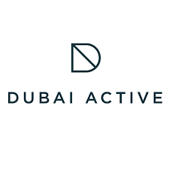
How? Key Strategies & Considerations - Brand Building
Middle East
EMEA
APAC
Europe
Notes:
Consider where and how to play. We selected MENA and APAC. Europe is a huge market for fitness and wellness but there are too many local and individual requirements.

Slide 12
How: Key Strategies & Considerations - Models
Fishing
Brand Licence
Partnerships
Collaborate & Learn
UK based operations
Hybrid QA model
Industry events – brand awareness & market penetration
Desk based research
Leverage domestic business operating overseas
Licence to practice model for chosen territories
Provision of content & processes
Replicate UK QA model
Utilise local knowledge & expertise
Provide training & consultation
Partner with other AOs
Build relationships with local government
Work with local regulators
Work with local registration authorities
Demand for UK quality vocational and technical qualifications is on the rise
Work with DBT
Invest in Trade Missions

Slide 13
How: Key Strategies & Considerations
Environment
Goals
USP
Pricing
Which countries/regions – select 3 maximum
Identify where you want to play and where you don’t want to play
Do your research and horizon scanning
What do you hope to achieve?
What would be your purpose overseas?
How would you define success?
What are your short, medium and long-term export goals?
What are your unique selling points?
How do they compare to your competitors?
Is your offer relevant to your desired audience?
What impact can you have?
What is the price point in the countries you want to export to?
Is it enough for a sustainable offer?
How does your price point compare to your competitors?

Slide 14
Support for your journey
LEARN KSA Conference
Vision 2030
9 & 10 September 2024
https://www.vision2030.gov.sa/en/vision-2030/overview/
Learn KSA Conference – 9th to 10th September 2024
https://learn-events.com/
https://awarding.org.uk/membership/q-uk/
Jonathan Ledger CMgr FCMI MIOD
Skills and Professional Bodies Specialist
International Education Team & Skills Directorate | Business Group
Department for Business and Trade
Mobile: +44 (0) 7798 692 213 |
E-mail: jonathan.ledger@businessandtrade.gov.uk
14

Slide 15
Safe Travels!
Jenny Patrickson, Managing Director, Active IQ – jenny.patrickson@activeiq.co.uk

