Slide 1
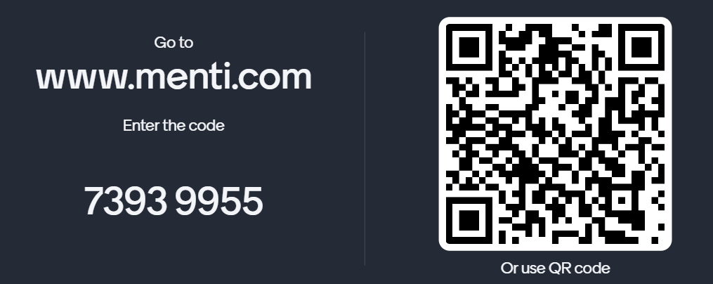
​
Open for business!
Ar agor i fusnes!
​
Elaine Carlile
Qualifications Wales
Cymwysterau Cymru
1 Mai 2024 1 May 2024

Slide 2
Cydnabod cyrff dyfarnu Recognition of awarding bodies

Slide 3
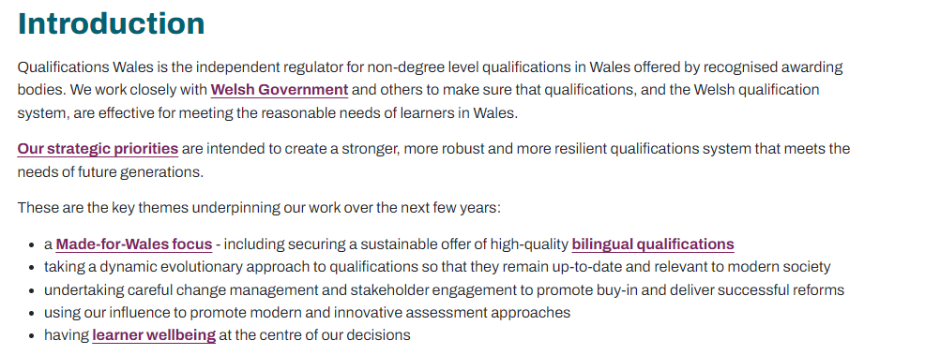
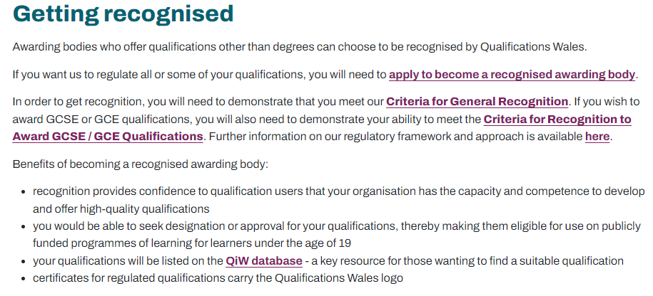
Cydnabod cyrff dyfarnu Recognition of awarding bodies
91 recognised awarding bodies
730, 415 certificates issued
Annual Qualifications Market Report: 2022 to 2023
https://qualifications.wales

Slide 4
Gofynion rheoleiddiol Regulatory requirements
Regulatory Document List
Rhestr Dogfennau Rheoleiddiol

Slide 5
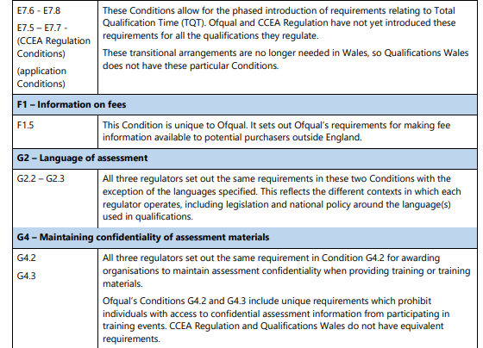
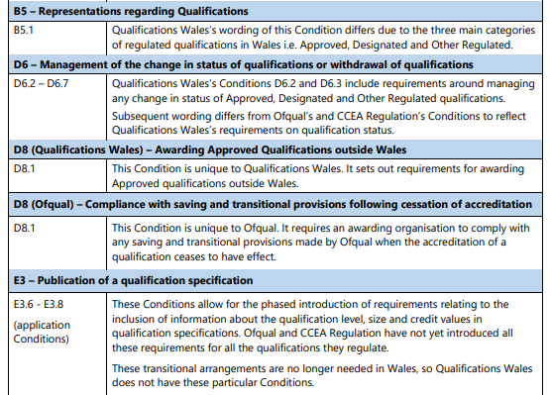
Amodau cydnabod - Conditions of recognition - – gwahaniaethau allweddol key differences

Slide 6
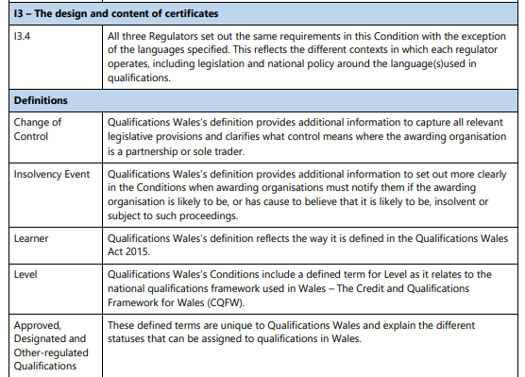
Amodau cydnabod - Conditions of recognition - – gwahaniaethau allweddol key differences

Slide 7
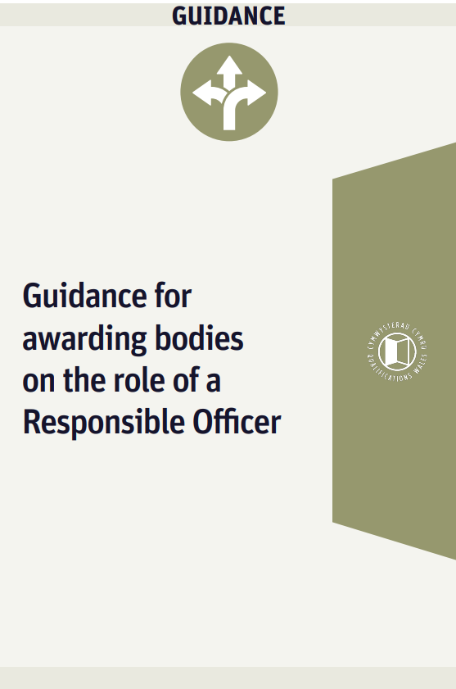
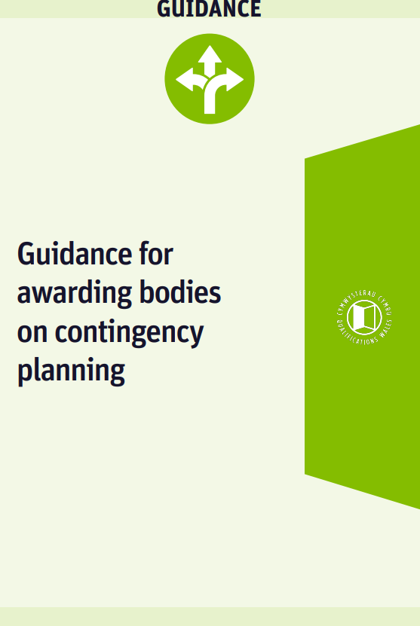
Arweiniad i gyrff dyfarnu Guidance for awarding bodies

Slide 8
Monitro cyrff dyfarnu Monitoring awarding bodies

Slide 9
Safbwyntiau allweddol i’w nodi Key points to note
I holi am about becoming a recognised awarding body- email datganiadcydymffurfiaeth@cymwysterau.cymru
Rhan 1: lleni’r ffurflen gais ragarweiniol
Rhan 2: llenwi’r ffurflen gais lawn– bydd angen I gais llawn ddangofs I fodloni’r Meini Prawf Cydanbod Cyrrredinol a’r potensial I gydmffurfio â’n Hamodau Cydnabod Safonol
Edrych ar y gwahnaiaethau mewn gofynion rheolleiddio ar draws gwledyddd y DU
Darllenwch ein dogfennau
cyfarwyddyd I gefnogi eich gwaith
Ymgyfarwyddo â’n rhester termau
To enquire about becoming a
recognised awarding body- email statementofcompliance@qualifications.wales
Part 1: completion of preliminary application
Part 2: completion of full application – need to demonstrate ability to meet the Criteria for General Recognition and potential to comply with our Standard Conditions of Recognition
Look at the differences in regulatory requirements across the UK nations
Read our guidance documents to
support your work
Familiarise yourself with our
glossary of terms

Slide 10
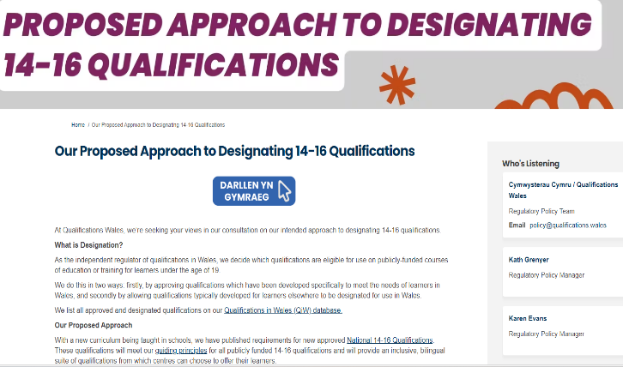
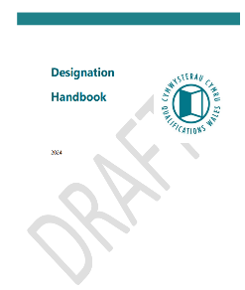
Cymwysterau Dynodedig ac wedi Designated and Approved Awdurdodi qualifications

Slide 12
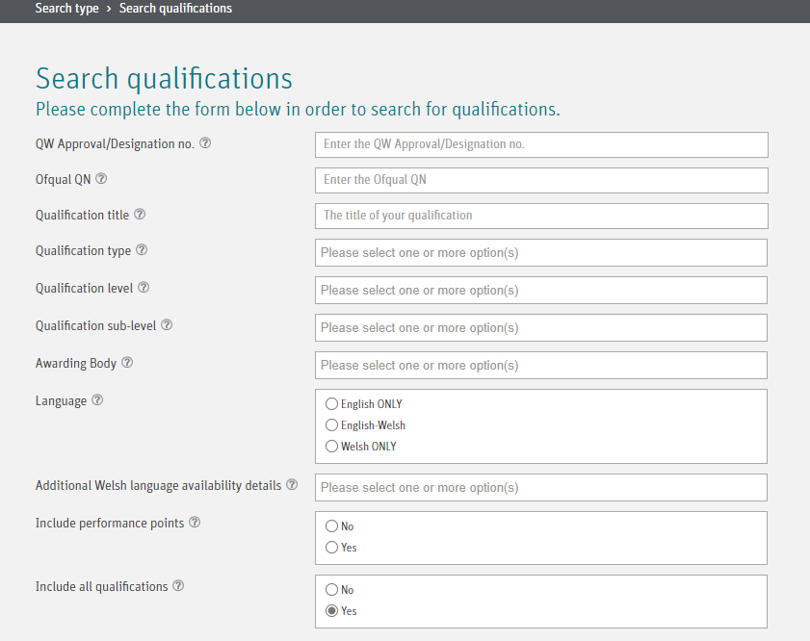
Cymwysterau yng Nghymru (QiW) Qualifications in Wales (QiW)

Slide 13
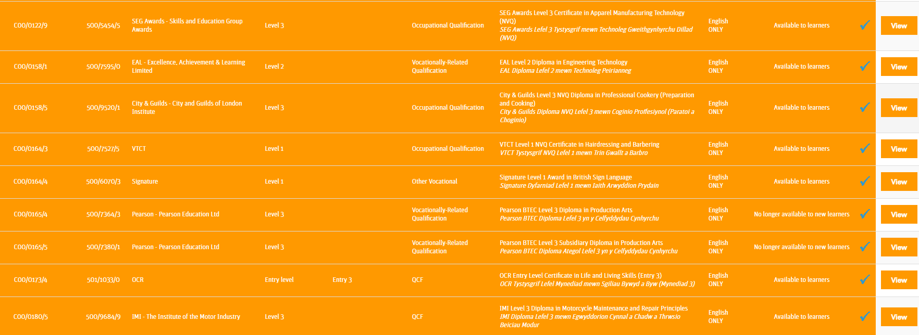
Cymwysterau yng Nghymru (QiW) Qualifications in Wales (QiW)

Slide 14
Safbwyntiau allweddol i’w nodi Key points to note
Pan fyddwch yn bwriadu tynnu cymhwyster yn ôl, neu newid statws cymhwyster, rhaid i chi:
Ein hysbysu ni am y newid a ragwelir
Paratoi, cynnal a chydymffurfio â chynllun ysgrifenedig yn brydlon, gan ddangos eich bod yn cymryd pob cam rhesymol i warchod buddiannau Dysgwyr
Darparu gwybodaeth glir a chywir am y newid i'r rhai sy'n debygol o gael eu heffeithio
Diweddaru cronfa ddata QiW
Cydymffurfio â'r holl Amodau Cydnabod wrth wneud y newid
Cydymffurfio ag unrhyw ofynion a gyflwynwn i chi yn ysgrifenedig
When you intend to withdraw a
qualification, or change the status of a
qualification, you must:
Notify us of the anticipated change
Promptly prepare, maintain and comply with a written plan, demonstrating that you take all reasonable steps to protects the interests of Learners
Provide clear and accurate information about the change to those likely to be affected
Update the QiW database
Comply with all the Conditions of Recognition when making the change
Comply with any requirements that we communicate to you in writing

Slide 15
Cymwysterau Cenedlaethol 14-16 National 14-16 Qualifications
 |  | Skills Suite
GCSEs | VCSEs | Skills for Life & Skills for Work Awards, Certificates and Diplomas | Personal Project
28 GCSEs (+2 related qualifications) 13 VCSEs (+3 subjects TBC) Level 1/Level 2 120 GLH* |  | 28 Skills for Life units 19 Skills for Work units Entry Level, Level 1 or Level 2 60-240 GLH | Any subject of learner’s choice Entry Level, Level 1 or Level 2 60 GLH
Foundation general subjects | Foundation work-related subjects
8 general subjects ** and 15 work-related subjects (+ Cymraeg TBC) Entry Level/ Level 1 120 GLH
*GLH = average number of guided learning hours per qualification ** details of international language pathway TBC

Slide 16
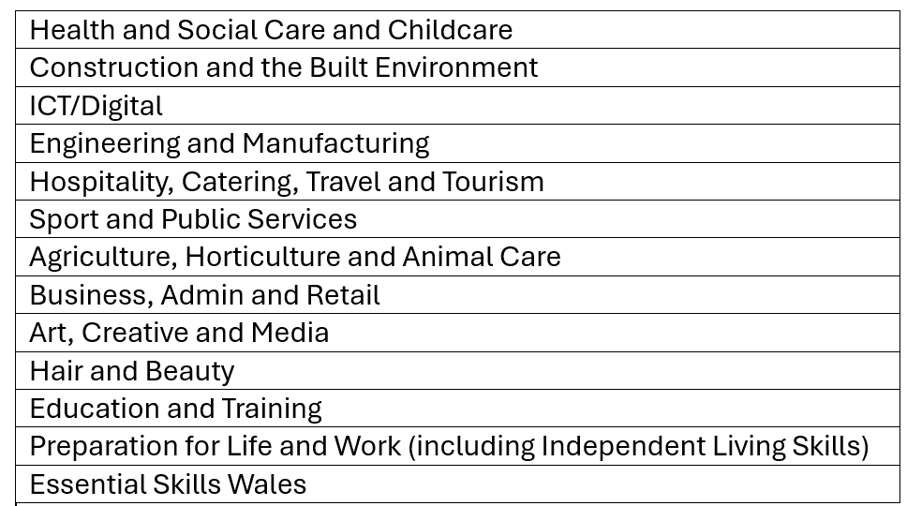
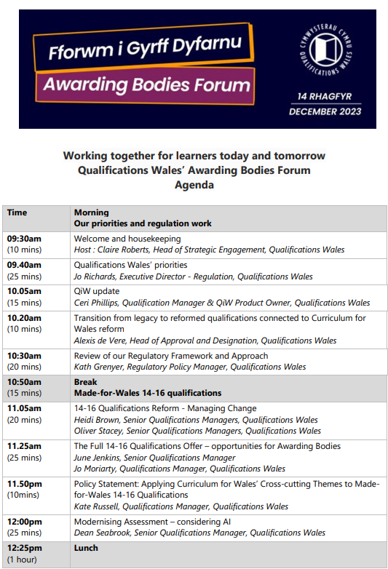
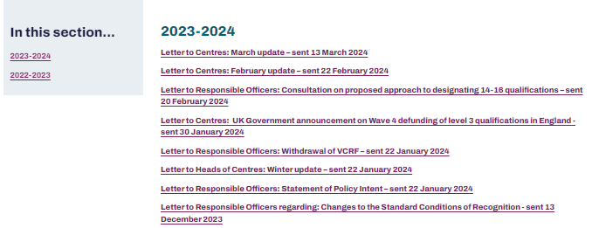
Ymgysylltu parhaus Ongoing engagement

Slide 17
Cewch mewn cysylltiad Keep in touch
Enquiries about being a recognised awarding body including ending or amending your recognition | statementofcompliance@qualifications.wales
Enquiries about Qualifications in Wales (QiW) database | enquiries@qualifications.wales
Enquiries about getting qualifications approved or designated by QW | approvalanddesignation@qualifications.wales
Notifications of an event that has or is likely to occur which could have an adverse effect | incidents@qualifications.wales
Enquiries about QW’s official statistics | statistics@qualifications.wales
Enquiries about QW’s research | research@qualifications.wales
General enquiries | enquiries@qualifications.wales
Media enquiries | comms@qualifications.wales

Slide 19
Thank you and questions
Diolch a chwestiynau
Elaine Carlile: elaine.carlile@qualifications.wales

